Slide 1



Employee Engagement Survey Advinus

Slide 2

Agenda
Context and Survey Objectives
Our Approach Survey Design
Survey Participation Key Findings
Survey Analysis
Recommendations & Next Steps Appendix

Slide 3
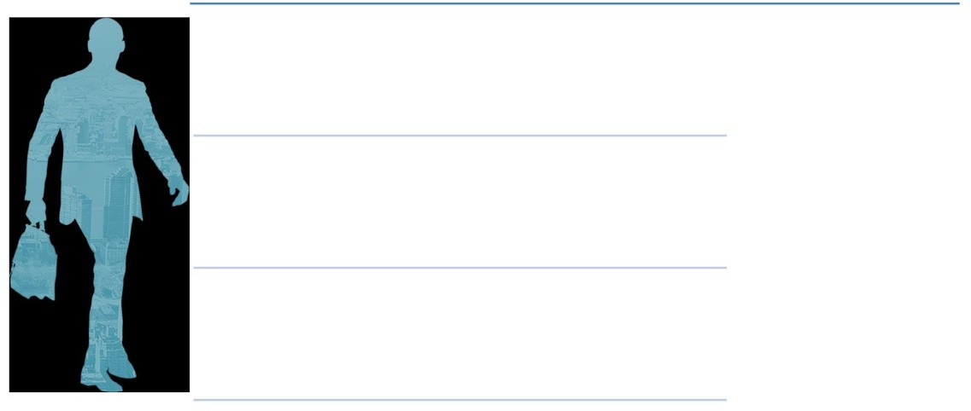
Survey Objective
The Advinus has engaged People Business to conduct an employee engagement survey
The model for engagement measurement comprises NPS and eNPS with Overall Factors of Pride-Advocacy-Loyalty-Overall Satisfaction and 10 distinct aspects of workplace realities (Workplace Dimensions) that has been measured through an online administered survey
Based on the feedback collected from the survey, set of actions will be taken by the organization to further improve Employee Engagement at the workplace.

Slide 4

Approach taken for Eurofins Advinus Employee Engagement Survey 2021
Survey Analysis & Presentation
Survey Launch
We are ere
Before launch of the survey, there was a communication shared with the employees about the survey. The
Customized Questionnaire
Discovery Discussion
There were Leadership discussions done by PB, with Top Management and BU/Functional
Heads and FGD’s with employees at the 4 levels in the organization across functions to understand typical areas that can be surveyed
Basis the discussions, customized questions were recommended by
PB and signed-off by Advinus
online survey was
launched on November 18, 2019

Slide 5
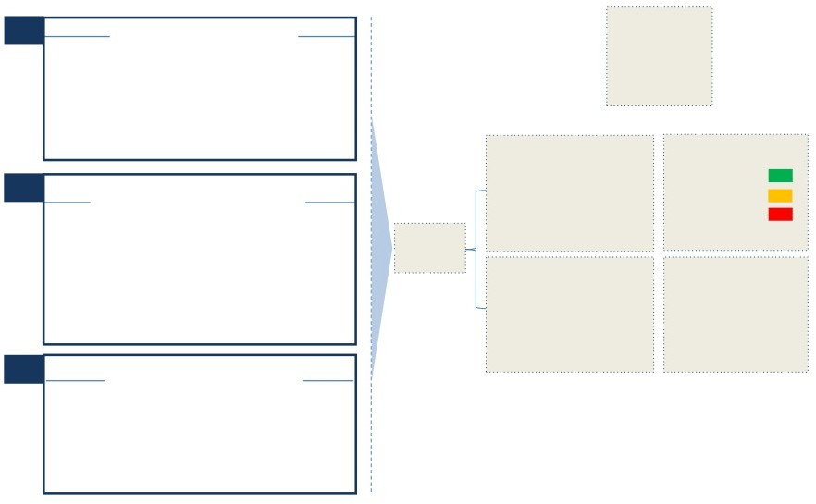
Survey Instrument Design & Scale
Total Number of Questions:
60
Employees perception on the dimensions which create engagement at work as indicated by the eNPS model
Dimensions
5: Strongly Agree
4: Agree
3: Neither Agree nor Disagree
2: Disagree
1: Strongly Disagree
Average Ratings
> 4.0
2.0 - 3.99
< 2.0
Employees assessment of their overall
satisfaction, willingness to advocate with a sense of pride and continue
working at Advinus
Scale Used
Employee/ Product Advocacy
Overall Measures / Employee Engagement
0 - 10
9 - 10: Promoters
7 - 8: Passives
0 - 6: Detractors
A breakup of Promoter, Passive & Detractor employees based on their responses

Slide 6

Survey Design: NPS and eNPS
Net Product Advocacy Score (NPS) is a ‘employee as a customer’ measurement taken from employees, asking them, how likely are they to recommend the organization’s product or service to others on a scale of 0-10.
eNPS stands for employee Net Promoter Score and is a way for organizations to measure employee loyalty. It measures the likelihood of whether an employee would be willing to recommend the organization as a place to work.
How likely would you be to recommend Advinus ’s
products / offerings and services to a friend or relative?
How likely would you recommend your organization as a place to work to a friend or relative?
NPS
eNPS
A good NPS score is 10 to 50, while the range is from -100 to 100

Slide 7
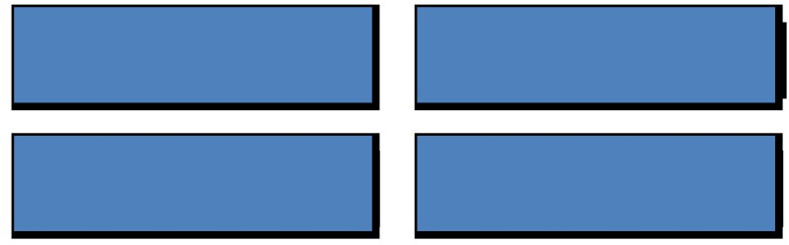
Survey Design: Pride-Advocacy-Loyalty-Overall Satisfaction
• Out of the 32 questions, the following questions measure - Pride,Advocacy,Loyalty,Overall Satisfaction for employees. These questions pertain to aspects of employee experience, which are important to drive engagement at Advinus .
I would recommend Advinus to my family and friends, for work
I feel proud to be a part of Advinus
Two years from now, I see myself continuing to work for Advinus
I am extremely satisfied with Advinus as a place to work

Slide 8
Survey Design: Workplace Dimensions
Workplace Dimensions
Details
Work Conditions | Quality Focus
Innovation | Communication
Managing Performance | Growth & Development
Team Work | Leadership of Business Ethics
Managing Change | Leadership
Qualitative Questions
Questions
What is the one thing you would want to change about your organization?
What is the one thing you would not want to change about your organization?

Slide 9
Advinus Survey Participation

Slide 10
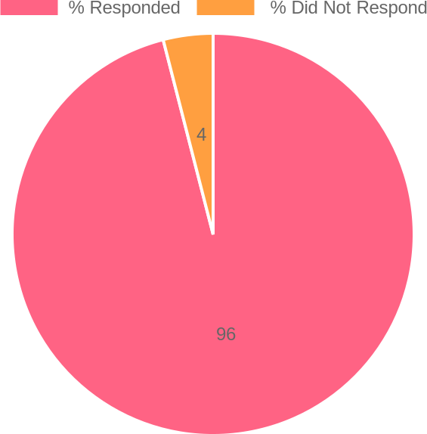
Survey Participation of Advinus - Overall
Advinus Overall Participation
 | Target Sample Size | Survey Response | Response Rate
Advinus Overall | 393 | 377 | 96.00%

Slide 11
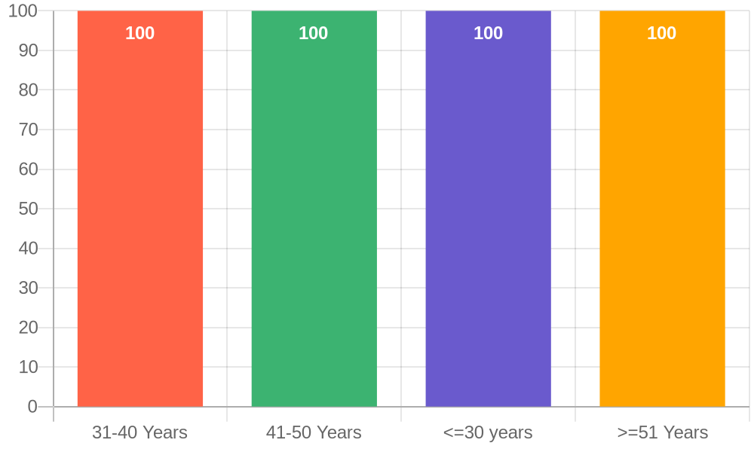
Survey Participation of Advinus
31-40 Years | 130
41-50 Years | 75
<=30 years | 144
>=51 Years | 28
Fig: Participation rate for different Age Groups

Slide 12
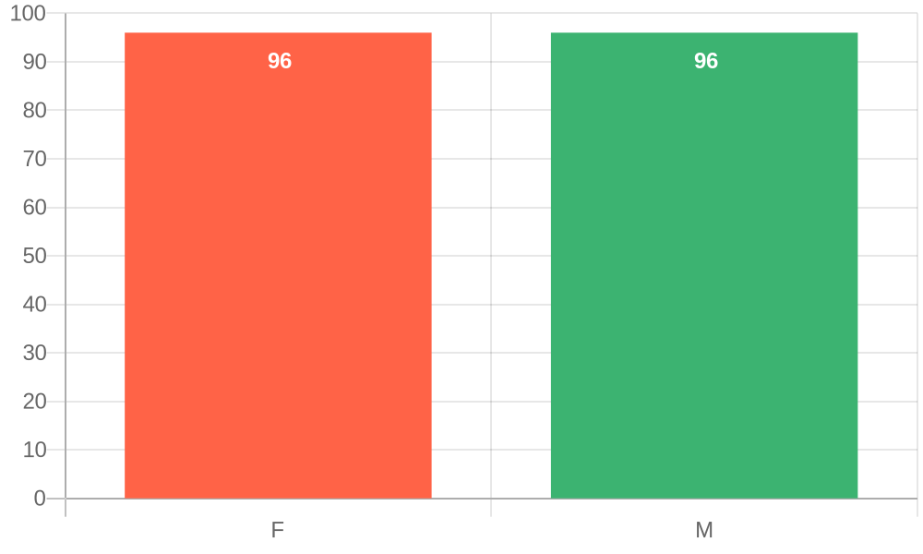
Survey Participation of Advinus
F | 117
M | 260
Fig: Participation rate for Gender

Slide 13
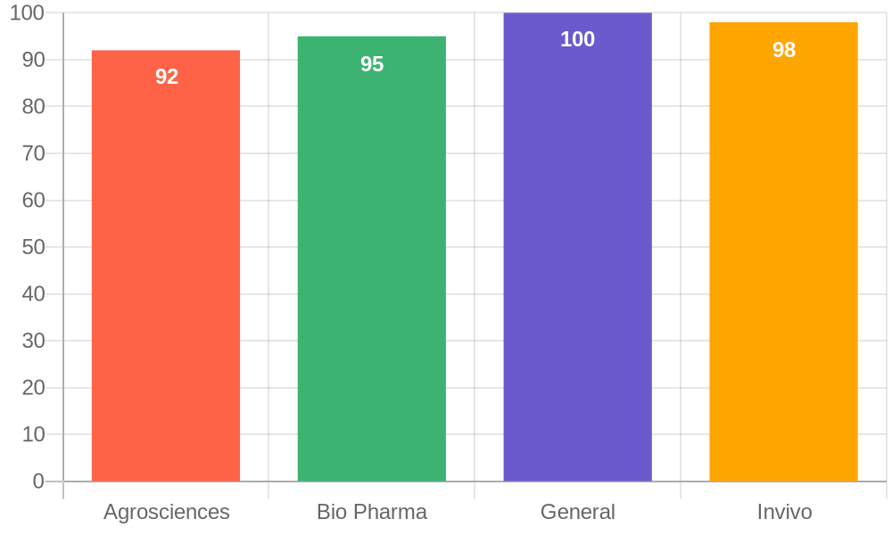
Survey Participation of Advinus
Agrosciences | 79
Bio Pharma | 128
General | 59
Invivo | 111
Fig: Participation rate for different Business Unit

Slide 14
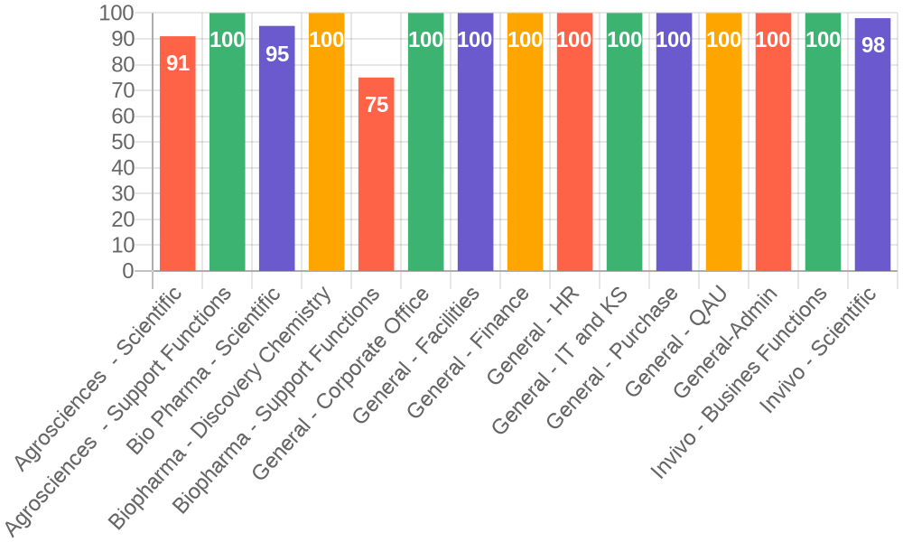
Survey Participation of Advinus
Agrosciences - Scientific | 70
Agrosciences - Support Functions | 9
Bio Pharma - Scientific | 104
Biopharma - Discovery Chemistry | 18
Biopharma - Support Functions | 6
General - Corporate Office | 3
General - Facilities | 8
General - Finance | 7
General - HR | 2
General - IT and KS | 7
General - Purchase | 5
General - QAU | 23
General-Admin | 4
Invivo - Busines Functions | 9
Invivo - Scientific | 102
Fig: Participation rate for different Divisions

Slide 15
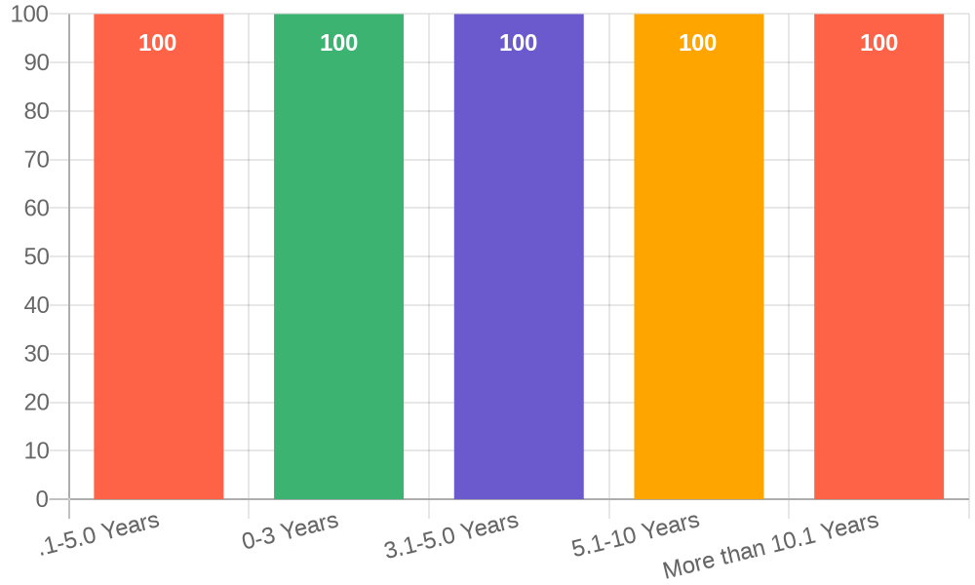
Survey Participation of Advinus
.1-5.0 Years | 6
0-3 Years | 146
3.1-5.0 Years | 75
5.1-10 Years | 43
More than 10.1 Years | 107
Fig: Participation rate according to Tenure

Slide 16
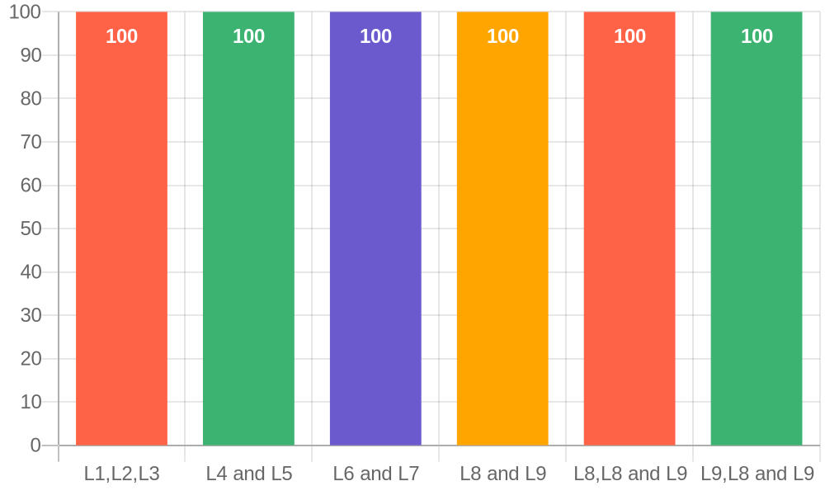
Survey Participation of Advinus
L1,L2,L3 | 12
L4 and L5 | 51
L6 and L7 | 160
L8 and L9 | 122
L8,L8 and L9 | 30
L9,L8 and L9 | 1
Fig: Participation rate Grade wise

Slide 17
Advinus Product Advocacy Analysis
Reference Question: How likely would you be to recommend your company as a great place to work to a friend or relative?

Slide 18
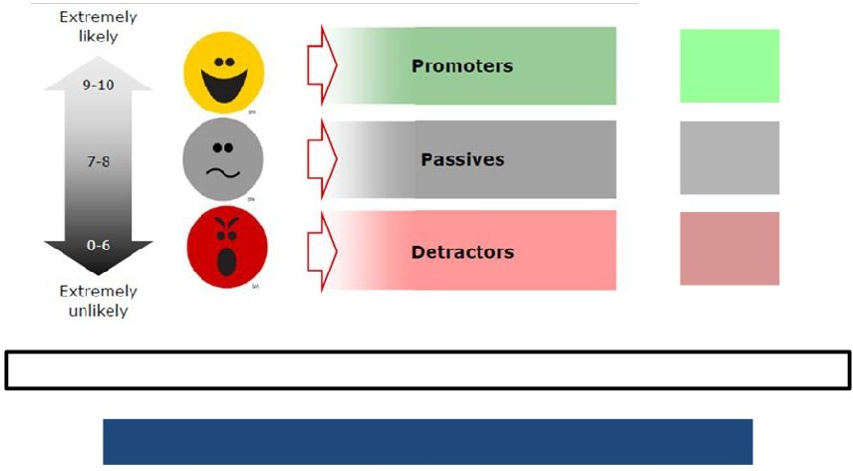
Product Advocacy
How likely would you be to recommend your company as a great place to work to a friend or relative
products / offering and services to a friend or relative?
% Recommended
34
41
24
Net Promoter Score = % Promoters - % Detractors
Net Product Advocacy Score(NPS) = 10

Slide 19
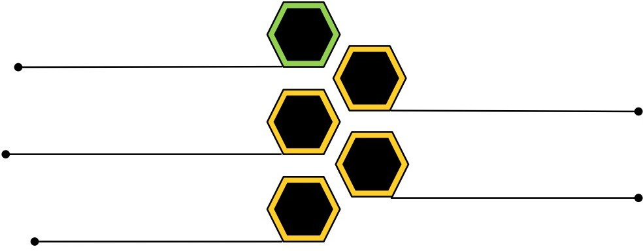
Key Findings
Net Product Advocacy Score (NPS) is the degree of likelihood an employee would
recommend company’s products / offering
and services to a friend or relative
NPS
Advinus has a Positive NPS score on scale
of (-100 -100). This shows the company has scope
for improvement*
+10
Passives indicates a disconnect and lack of product advocacy in employees about the company’s products and services. It can be due to multiple factors
41%
+31
Employees with Tenure(5-7yrs)in the company are
recommending products/ services of Advinus
the most
Approximately 50% of the young employees
in the age group of (26-40)yrs are passives
indicate the disconnect and lack of product 50%
knowledge among the young employees.
*NPS score higher than 30 would indicate that the company has far more engaged employees than disengaged ones on products and services
An NPS over 50 means your internal/external customers love you and your company is generating a lot of positive word-of-mouth from
h_{th}ig_{e}h_{ir}e_{r}r_{e}y_{fe}o_{r}u_{ra}r _{l}N_{s.}P_{T}S_{h}i_{e}s, the more likely it is that your referrals will convert into new leads and more revenue for your company

Slide 20
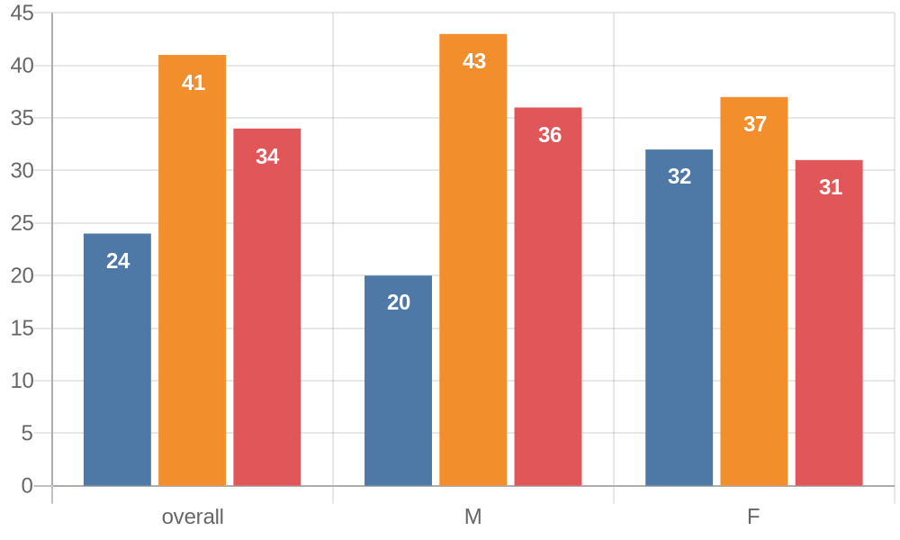
Employee Product Advocacy Scores - By Gender
Base | 377 | 260 | 117
Scores | 10 | 16 | -1
Average Scores | 5.00 | 8.00 | -0.50

Slide 21
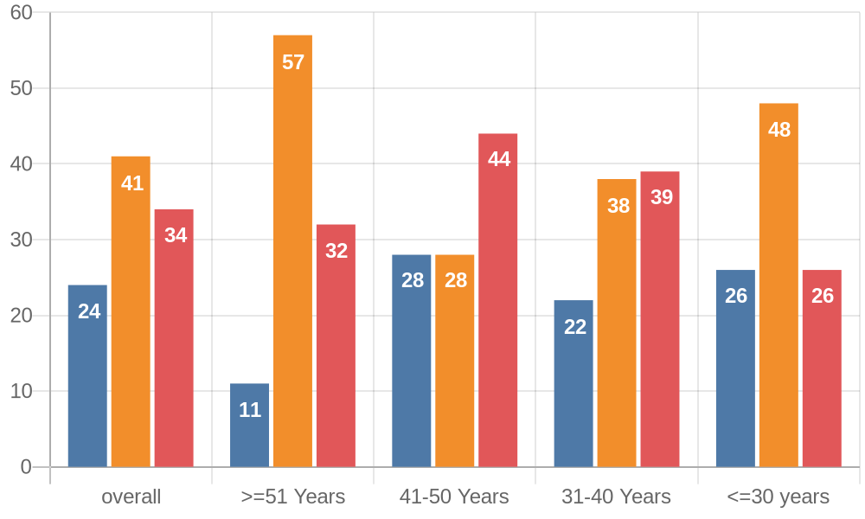
Employee Product Advocacy Scores - By Age
Base | 377 | 28 | 75 | 130 | 144
Scores | 10 | 21 | 16 | 17 | 0
Average Scores | 5.00 | 10.50 | 8.00 | 8.50 | 0.00

Slide 22
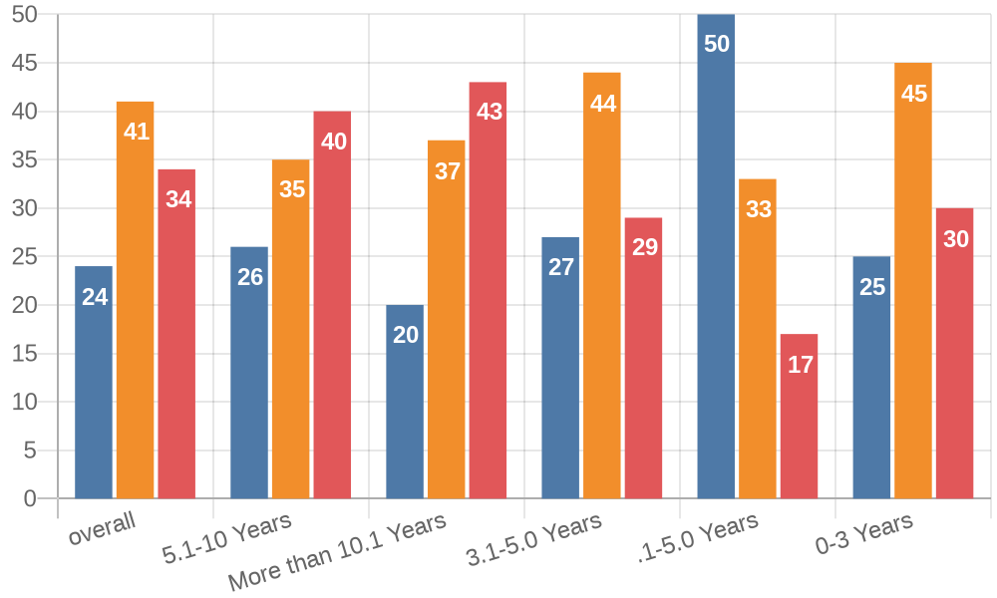
Employee Product Advocacy Scores - By Tenure
Base | 377 | 43 | 107 | 75 | 6 | 146
Scores | 10 | 14 | 23 | 2 | -33 | 5
Average Scores | 5.00 | 7.00 | 11.50 | 1.00 | -16.50 | 2.50

Slide 23
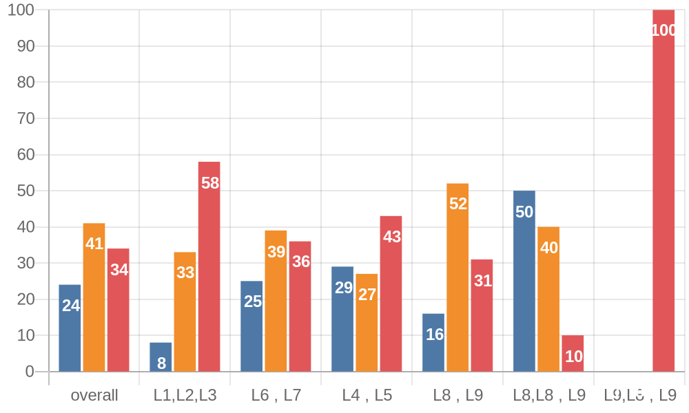
Employee Product Advocacy Scores - By Grade
Base | 376 | 12 | 160 | 51 | 122 | 30 | 1
Scores | 10 | 50 | 11 | 14 | 15 | -40 | 100
Average Scores | 5.00 | 25.00 | 5.50 | 7.00 | 7.50 | -20.00 | 50.00

Slide 24
Advinus Product Advocacy Analysis
Reference Question: How likely would you be to recommend your company offering and services?

Slide 25
Product Advocacy
How likely would you be to recommend your company offering and services
products / offering and services to a friend or relative?
% Recommended
42
39
19
Net Promoter Score = % Promoters - % Detractors
Net Product Advocacy Score(NPS) = 10

Slide 26
Key Findings
Net Product Advocacy Score (NPS) is the degree of likelihood an employee would
recommend company’s products / offering
and services to a friend or relative
NPS
Advinus has a Positive NPS score on scale
of (-100 -100). This shows the company has scope
for improvement*
+10
Passives indicates a disconnect and lack of product advocacy in employees about the company’s products and services. It can be due to multiple factors
41%
+31
Employees with Tenure(5-7yrs)in the company are
recommending products/ services of Advinus
the most
Approximately 50% of the young employees
in the age group of (26-40)yrs are passives
indicate the disconnect and lack of product 50%
knowledge among the young employees.
*NPS score higher than 30 would indicate that the company has far more engaged employees than disengaged ones on products and services
An NPS over 50 means your internal/external customers love you and your company is generating a lot of positive word-of-mouth from
h_{th}ig_{e}h_{ir}e_{r}r_{e}y_{fe}o_{r}u_{ra}r _{l}N_{s.}P_{T}S_{h}i_{e}s, the more likely it is that your referrals will convert into new leads and more revenue for your company

Slide 27
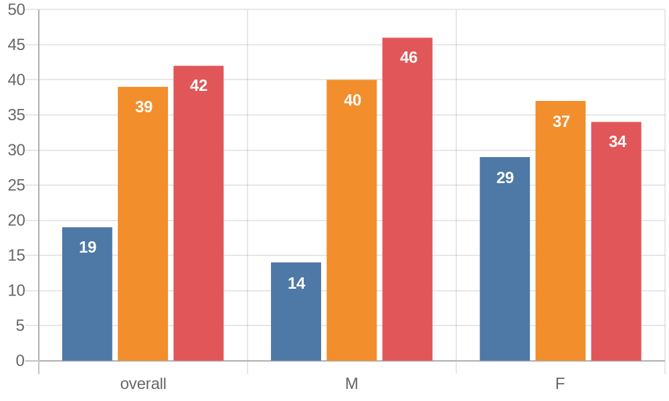
Employee Product Advocacy Scores - By Gender
Base | 377 | 260 | 117
Scores | 23 | 32 | 5
Average Scores | 11.50 | 16.00 | 2.50

Slide 28
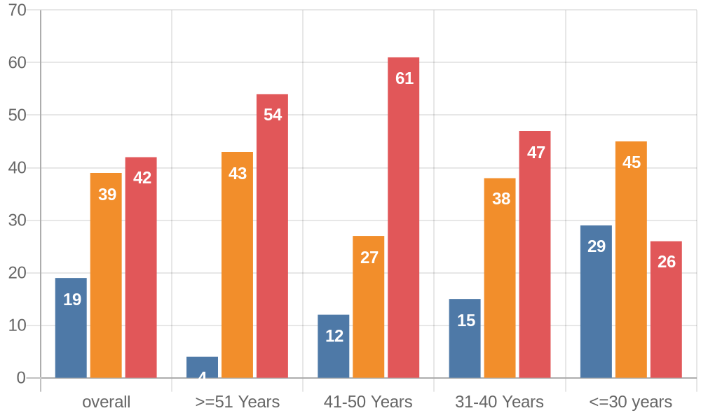
Employee Product Advocacy Scores - By Age
Base | 377 | 28 | 75 | 130 | 144
Scores | 23 | 50 | 49 | 32 | -3
Average Scores | 11.50 | 25.00 | 24.50 | 16.00 | -1.50

Slide 29
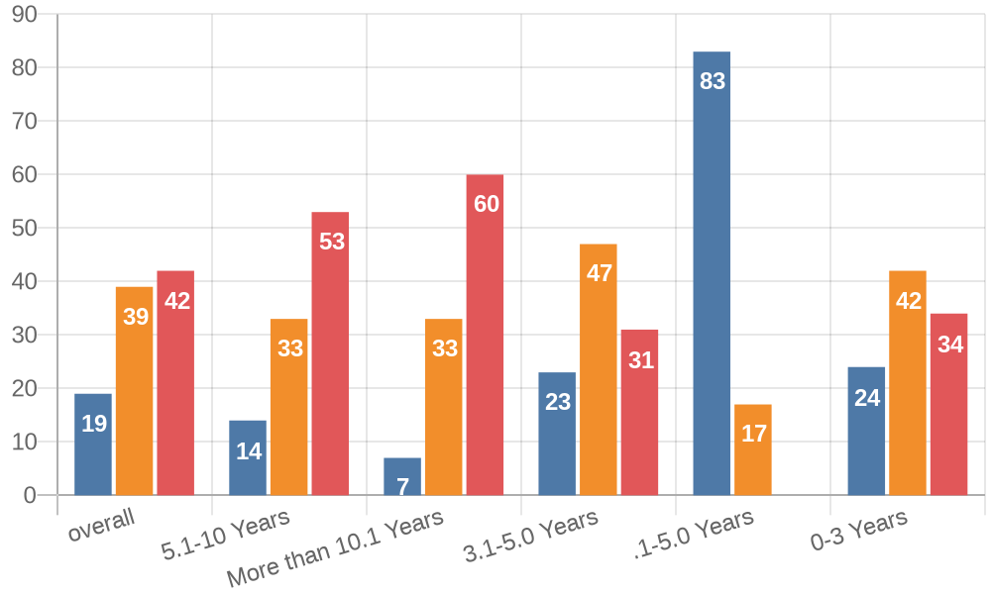
Employee Product Advocacy Scores - By Tenure
Base | 377 | 43 | 107 | 75 | 6 | 146
Scores | 23 | 39 | 53 | 8 | -83 | 10
Average Scores | 11.50 | 19.50 | 26.50 | 4.00 | -41.50 | 5.00

Slide 30
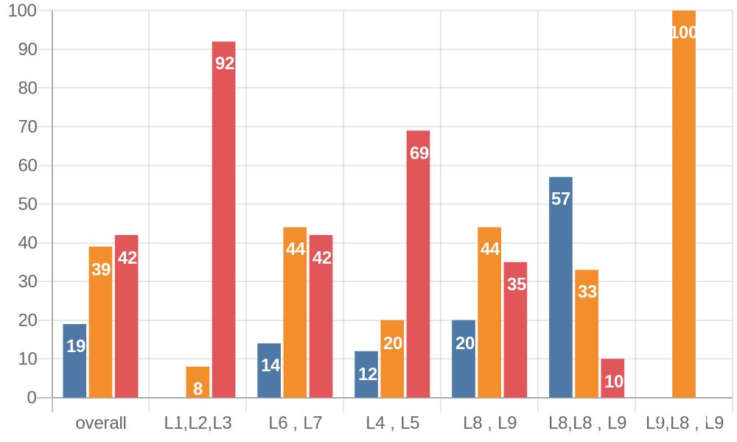
Employee Product Advocacy Scores - By Grade
Base | 376 | 12 | 160 | 51 | 122 | 30 | 1
Scores | 23 | 92 | 28 | 57 | 15 | -47 | 0
Average Scores | 11.50 | 46.00 | 14.00 | 28.50 | 7.50 | -23.50 | 0.00

Slide 31
Analysis of
Pride-Advocacy-Loyalty-Overall Satisfaction

Slide 32
Key Insights
Pride
Loyalty
• 90% of employees are proud of working with the Company Name . This isorganization
• The sense of continuing in the organization for next 2 years is highest in
Advocacy
Satisfaction
• The sense of recommending the organization as a place of work, is highest
• The

Slide 33
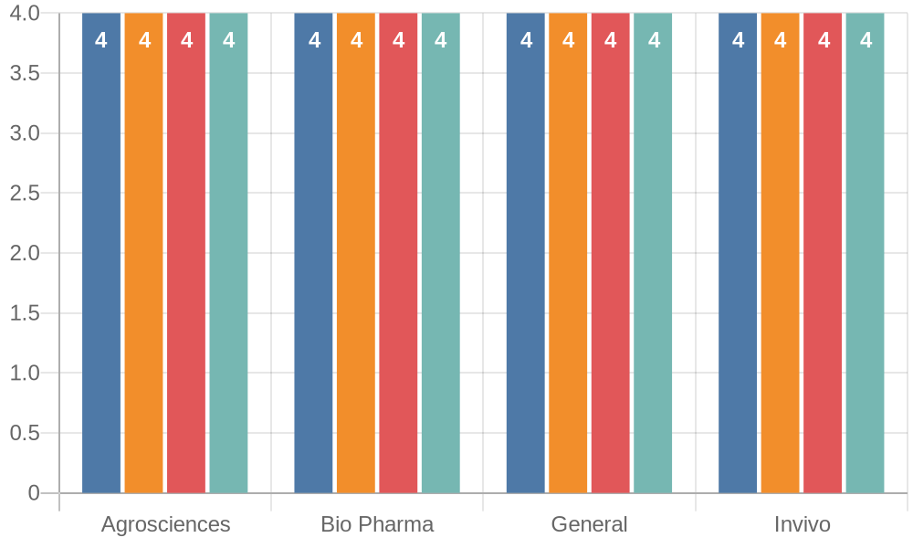
Overall Dimensions – Business Unit
Base | 59 | 128 | 111 | 79

Slide 34
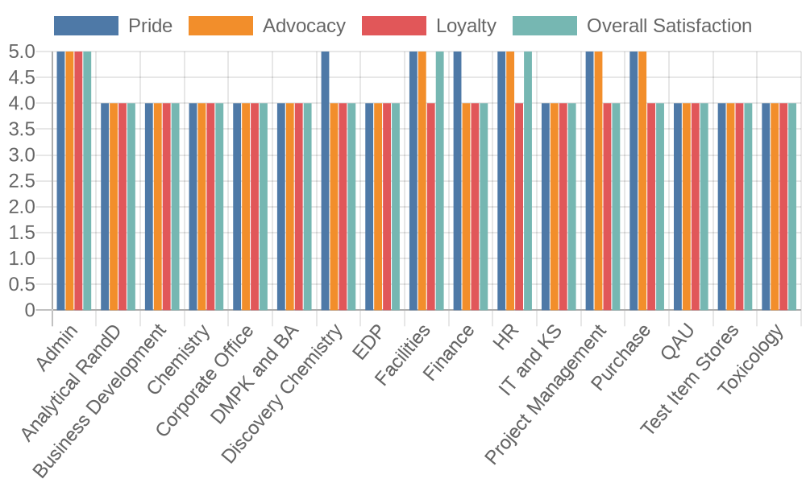
Overall Dimensions – Department
Base | 3 | 62 | 96 | 68 | 23 | 6 | 5 | 7 | 9 | 7 | 18 | 39 | 5 | 2 | 4 | 15 | 8

Slide 35
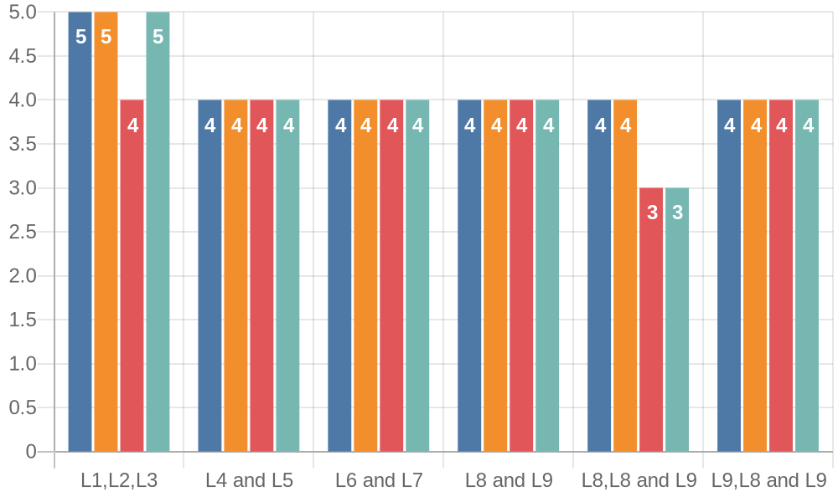
Overall Dimensions – Grade
Base | 12 | 160 | 51 | 122 | 30 | 1

Slide 36
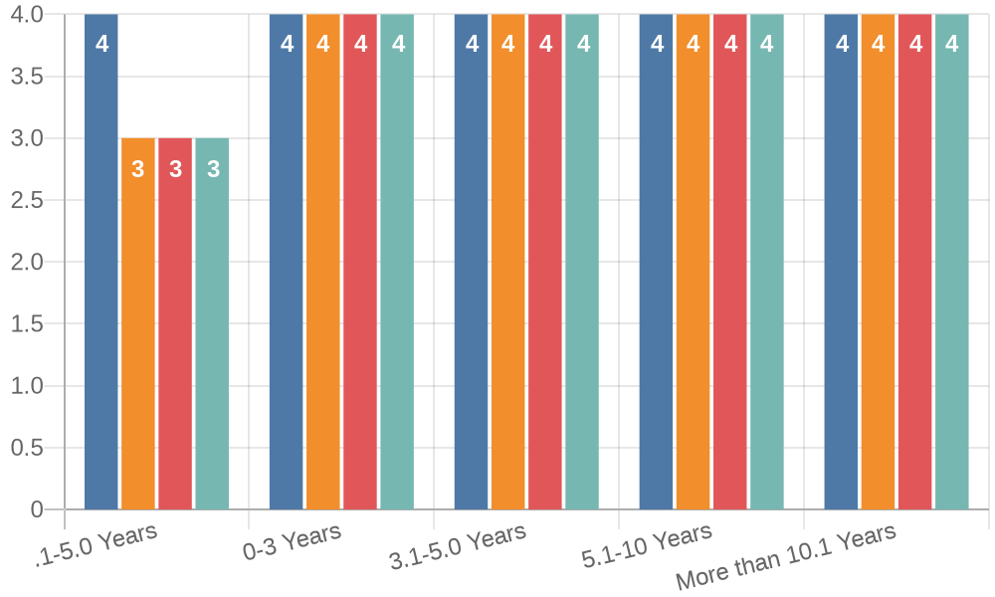
Overall Dimensions – Tenure
Base | 43 | 107 | 75 | 6 | 146

Slide 37
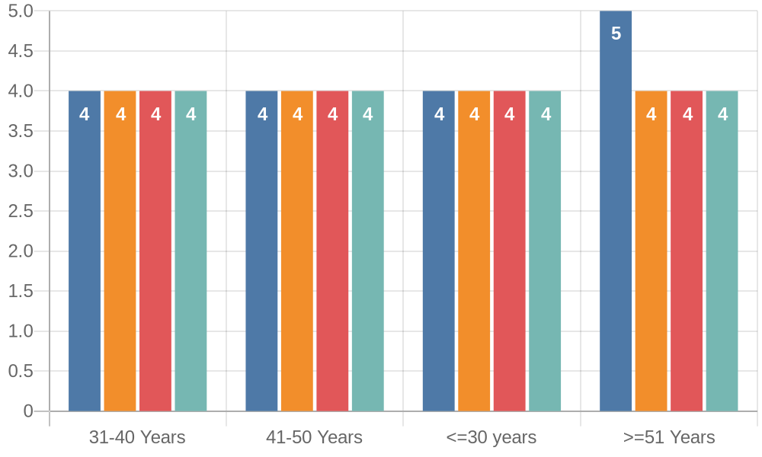
Overall Dimensions – Age
Base | 28 | 75 | 130 | 144

Slide 38
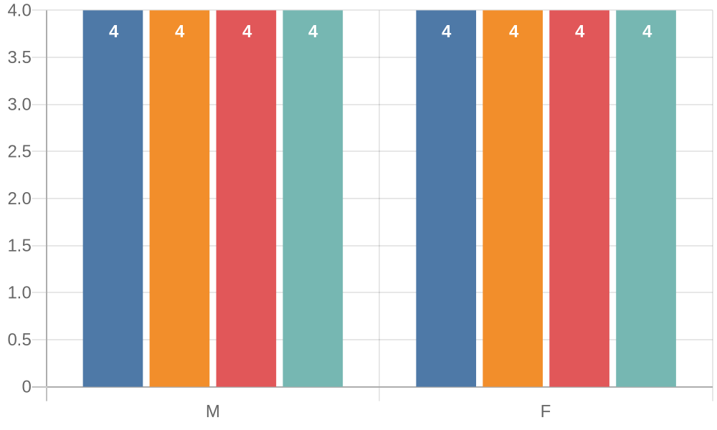
Overall Dimensions – Age
Base
260
117

Slide 39
Top 5 and Bottom 5 Questions
Question | Dimension | Avg. Rating | (Rating 4/5) % | (Rating 1/2/3) %
I feel proud to be a part of Eurofins Advinus | Pride | 4.29 | 94% | 6%
Integrity of data that I generate is critical for the success of the organization | Leadership of Business Ethics | 4.33 | 95% | 5%
The organization has made available policies related to ethics/code of conduct to employees and provided training | Leadership of Business Ethics | 4.19 | 95% | 5%
Question | Dimension | Avg. Rating | (Rating 4/5) % | (Rating 1/2/3) %
My successes are recognized by my manager and co-workers | Managing Performance | 3.78 | 73% | 27%
High performance is adequately rewarded at Eurofins Advinus | Managing Performance | 3.54 | 61% | 39%
Eurofins Advinus is committed to providing high-quality service to its customers | Quality Focus | 3.41 | 70% | 30%
I believe that I have adequate opportunities for growth in my organization | Growth & Development | 3.73 | 72% | 28%
I am satisfied with the speed of decision making in Eurofins Advinus | Leadership | 3.82 | 73% | 27%

Slide 40
Overall Dimension Questions – Q1 to Q6
Dimension Questions | Dimension | Strongly Disagree % | Disagree % | Neither Agree nor Disagree % | Agree % | Strongly Agree % | Agreeing % | Not Agreeing % | Advinus Overall
Q1) I feel proud to be a part of Eurofins Advinus | Pride | 0.53 | 1.06 | 4.51 | 56.23 | 37.67 | 93.90 | 6.10 | 4.29
Q2) I will recommend Eurofins Advinus as a great place to work | Advocacy | 0.80 | 1.59 | 9.55 | 59.42 | 28.65 | 88.06 | 11.94 | 4.14
Q3) Two years from now, I see myself continuing to work for Eurofins Advinus | Loyalty | 1.33 | 2.65 | 22.28 | 50.40 | 23.34 | 73.74 | 26.26 | 3.92
Q4) I am extremely satisfied with Eurofins Advinus as a place to work | Overall Satisfaction | 0.53 | 3.98 | 13.53 | 61.01 | 20.95 | 81.96 | 18.04 | 3.98
Q5) I have access to all the necessary facilities to work effectively at my office | Work Conditions | 1.06 | 7.43 | 9.81 | 64.46 | 17.24 | 81.70 | 18.30 | 3.89
Q6) Eurofins Advinus ensures healthy and safe working conditions | Work Conditions |  | 2.65 | 8.75 | 65.78 | 22.81 | 88.59 | 11.41 | 4.09

Slide 41
Overall Dimension Questions – Q7 to Q12
Dimension Questions | Dimension | Strongly Disagree % | Disagree % | Neither Agree nor Disagree % | Agree % | Strongly Agree % | Agreeing % | Not Agreeing % | Advinus Overall
Q7) I feel encouraged to come up with new and better ways of doing things | Innovation | 1.06 | 3.98 | 11.67 | 64.99 | 18.30 | 83.29 | 16.71 | 3.95
Q8) My successes are recognized by my manager and co- workers | Managing Performance | 2.12 | 7.16 | 17.77 | 56.50 | 16.45 | 72.94 | 27.06 | 3.78
Q9) High performance is adequately rewarded at Eurofins Advinus | Managing Performance | 2.39 | 11.67 | 24.67 | 52.52 | 8.75 | 61.27 | 38.73 | 3.54
Q10) My manager gives me feedback on my job performance | Managing Performance | 1.06 | 3.71 | 14.06 | 61.01 | 20.16 | 81.17 | 18.83 | 3.95
Q11) I am given the necessary authority to carry out my work effectively | Managing Performance | 1.06 | 2.12 | 7.69 | 67.90 | 21.22 | 89.12 | 10.88 | 4.06
Q12) There is good teamwork and cooperation between departments/teams at Eurofins Advinus | Team Work | 1.33 | 2.92 | 16.71 | 58.09 | 20.95 | 79.05 | 20.95 | 3.94

Slide 42
Overall Dimension Questions – Q13 to Q18
Dimension Questions | Dimension | Strongly Disagree % | Disagree % | Neither Agree nor Disagree % | Agree % | Strongly Agree % | Agreeing % | Not Agreeing % | Advinus Overall
Q13) My team helps me operate at my best | Team Work | 0.27 | 2.65 | 9.28 | 63.40 | 24.40 | 87.80 | 12.20 | 4.09
Q14) I believe that the transition to the new ownership (Eurofins) has brought higher growth and better business opportunities | Managing Change | 0.27 | 1.06 | 15.65 | 63.40 | 19.63 | 83.02 | 16.98 | 4.01
Q15) There is no negative impact on my work with the transition of the ownership to Eurofins | Managing Change | 0.53 | 2.39 | 10.08 | 65.78 | 21.22 | 87.00 | 13.00 | 4.05
Q16) I am happy with the transition to new ownership (Eurofins) | Managing Change | 0.80 | 2.39 | 18.57 | 58.09 | 20.16 | 78.25 | 21.75 | 3.94
Q17) Eurofins Advinus is committed to providing high- quality service to its customers | Quality Focus | 19.36 | 7.96 | 2.39 | 52.79 | 17.51 | 70.29 | 29.71 | 3.41
Q18) My manager communicates the organization's goals to me | Communication | 1.33 | 2.65 | 13.00 | 62.86 | 20.16 | 83.02 | 16.98 | 3.98

Slide 43
Overall Dimension Questions – Q19 to Q24
Dimension Questions | Dimension | Strongly Disagree % | Disagree % | Neither Agree nor Disagree % | Agree % | Strongly Agree % | Agreeing % | Not Agreeing % | Advinus Overall
Q19) My manager listens to my ideas, opinions and concerns | Communication | 1.59 | 3.45 | 13.00 | 58.89 | 23.08 | 81.96 | 18.04 | 3.98
Q20) I believe that the leadership communicates effectively with the rest of the organization | Communication | 0.27 | 5.04 | 15.92 | 66.31 | 12.47 | 78.78 | 21.22 | 3.86
Q21) My manager supports my growth and development in my current role | Growth & Development | 2.39 | 4.51 | 12.73 | 57.56 | 22.81 | 80.37 | 19.63 | 3.94
Q22) At Eurofins Advinus, I have received adequate training necessary to do my job well | Growth & Development | 0.80 | 6.63 | 14.59 | 63.13 | 14.85 | 77.98 | 22.02 | 3.85
Q23) I believe that I have adequate opportunities for growth in my organization | Growth & Development | 2.12 | 5.04 | 20.42 | 62.33 | 10.08 | 72.41 | 27.59 | 3.73
Q24) My manager coaches me to build my skills | Growth & Development | 2.12 | 6.63 | 14.32 | 58.89 | 18.04 | 76.92 | 23.08 | 3.84

Slide 44
Overall Dimension Questions – Q25 to Q30
Dimension Questions | Dimension | Strongly Disagree % | Disagree % | Neither Agree nor Disagree % | Agree % | Strongly Agree % | Agreeing % | Not Agreeing % | Advinus Overall
Q25) The organization has mechanism to report any actual or possible ethical violations | Leadership of Business Ethics |  | 1.86 | 7.96 | 69.76 | 20.42 | 90.19 | 9.81 | 4.09
Q26) I strongly believe that the organization encourages everyone to comply with the ethical practices and organizational policies | Leadership of Business Ethics |  | 1.59 | 4.51 | 69.23 | 24.67 | 93.90 | 6.10 | 4.17
Q27) Integrity of data that I generate is critical for the success of the organization | Leadership of Business Ethics | 0.27 | 1.33 | 3.71 | 54.11 | 40.58 | 94.69 | 5.31 | 4.33
Q28) The organization has made available policies related to ethics/code of conduct to employees and provided training | Leadership of Business Ethics | 0.53 | 0.80 | 3.98 | 68.44 | 26.26 | 94.69 | 5.31 | 4.19
Q29) In the past 2 years, there has been positive changes at Eurofins Advinus | Leadership | 1.86 | 4.77 | 19.10 | 53.05 | 21.22 | 74.27 | 25.73 | 3.87
Q30) I have full confidence in our leaders’ decisions and direction | Leadership | 1.33 | 2.12 | 17.51 | 60.21 | 18.83 | 79.05 | 20.95 | 3.93

Slide 45
Overall Dimension Questions – Q31 to Q36
Dimension Questions | Dimension | Strongly Disagree % | Disagree % | Neither Agree nor Disagree % | Agree % | Strongly Agree % | Agreeing % | Not Agreeing % | Advinus Overall
Q31) I feel connected with the vision of my organization | Leadership | 0.53 | 1.86 | 10.34 | 70.29 | 16.98 | 87.27 | 12.73 | 4.01
Q32) I am satisfied with the speed of decision making in Eurofins Advinus | Leadership | 0.27 | 3.71 | 22.55 | 60.48 | 13.00 | 73.47 | 26.53 | 3.82

Slide 46
Advinus Workplace Dimensions

Slide 47
Workplace Dimensions Business Unit - Overall (N = 377)
Avg Scores
Work Conditions
Innovation
Managing Performance Team Work
Managing Change Quality Focus Communication Growth & Development
Leadership of Business Ethics Leadership
1% | 5% |  | 9% |  | 65% |  |  |  |  |  |  |  |  |  | 20%
1% | 4% | 12% |  |  |  | 65% |  |  |  |  |  |  |  |  | 18%
2% | 6% |  |  | 16% |  |  |  |  |  | 59% |  |  |  |  |  | 17%
1% | 3% | 13% |  |  |  | 61% |  |  |  |  |  |  |  | 23%
1% | 2% | 15% |  |  |  |  |  | 62% |  |  |  |  |  |  | 20%
19% |  |  |  |  |  |  | 8% |  |  |  | 2% 53% |  |  |  | 18%
1% | 4% | 14% |  |  |  |  |  | 63% |  |  |  |  |  |  | 19%
2% | 6% |  | 16% |  |  |  |  |  | 60% |  |  |  |  |  |  | 16%
1% | 5% |  | 65% |  |  |  |  |  |  |  |  |  | 28%
1% | 3% | 17% |  |  |  |  |  |  | 61% |  |  |  |  |  |  | 18%
3.99
3.95
3.83
4.02
4.00
3.41
3.94
3.84
4.20
3.91
Strongly Disagree
Disagree Neither Agree or Disagree
Agree Strongly Agree

Slide 48
Workplace Dimensions Business Unit 1 - Agrosciences (N = 79)
Avg Scores
Work Conditions
Innovation
Managing Performance Team Work
Managing Change Quality Focus Communication Growth & Development
Leadership of Business Ethics Leadership
1% 4% 8% 72% 15% 4% 10% 75% 11%
2% | 6% |  |  |  | 13% |  |  | 66% |  |  |  | 13%
1% | 4% |  | 11% |  |  |  | 68% |  |  |  | 15%
2% | 4% |  | 12% |  |  |  | 69% |  |  |  |  | 14%
 |  |  |  |  |  |  |  |  | 4% 57% 14%
10% |  |  |  |  | 15%
2% | 3% | 11% |  |  |  | 73% |  |  |  |  |  |  | 12%
1% | 7% |  |  |  | 13% |  |  | 67% |  |  |  |  | 12%
1% | 5% |  |  | 77% |  |  |  |  |  | 16%
3% 5% 16% 68% 7%
3.96
3.94
3.81
3.92
3.89
3.49
3.90
3.81
4.08
3.71
Strongly Disagree
Disagree Neither Agree or Disagree
Agree Strongly Agree

Slide 49
Workplace Dimensions Business Unit 2 - Bio Pharma (N = 128)
Avg Scores
Work Conditions
Innovation
Managing Performance Team Work
Managing Change Quality Focus Communication Growth & Development
Leadership of Business Ethics Leadership
1% | 7% |  |  |  | 12% |  |  |  | 63% |  |  |  |  |  |  |  |  |  |  | 18%
1% | 6% |  |  | 14% |  |  |  |  |  | 55% |  |  |  |  |  |  | 23%
2% | 6% |  |  | 19% |  |  |  |  |  |  |  | 55% |  |  |  |  |  |  | 18%
1% | 1% | 12% |  |  |  | 63% |  |  |  |  |  |  |  |  |  |  |  | 23%
2% | 16% |  |  |  |  |  | 61% |  |  |  |  |  |  |  |  |  |  | 21%
 |  |  |  |  |  |  |  |  |  |  |  |  | 2% |  | 48% |  |  |  |  |  | 16%
26% |  |  |  |  |  |  |  |  |  |  | 9%
1% | 4% |  | 13% |  |  |  |  | 59% |  |  |  |  |  |  |  |  |  | 22%
2% | 5% |  | 18% |  |  |  |  |  |  |  | 59% |  |  |  |  |  |  |  |  | 17%
2% | 5% |  |  | 64% |  |  |  |  |  |  |  |  |  |  |  | 28%
3% |  |  |  | 19% |  |  |  |  |  |  |  |  |  | 56% |  |  |  |  |  | 21%
3.89
3.95
3.82
4.06
4.01
3.18
3.97
3.85
4.17
3.95
Strongly Disagree
Disagree Neither Agree or Disagree
Agree Strongly Agree

Slide 50
Workplace Dimensions Business Unit 3 - General (N = 59)
Avg Scores
Work Conditions
Innovation
Managing Performance Team Work
Managing Change Quality Focus Communication Growth & Development
Leadership of Business Ethics Leadership
7% |  |  |  | 6% |  |  | 60% |  |  |  |  |  |  |  | 27%
3% 2%
 |  | 3% |  | 12% |  |  |  | 54% |  |  |  |  |  |  | 27%
 |  | 7% 17% 51% 23%
5% |  |  | 17% |  |  |  |  |  |  | 53% |  |  |  |  |  | 25%
1% 2% 12% 59% 26%
20% |  |  |  |  |  |  |  |  | 3% |  | 3% | 51% |  |  |  |  | 22%
1% 1% 1% 1% | 5% |  |  |  | 16% |  |  |  |  |  | 54% |  |  |  |  |  | 25%
 | 9% |  |  |  |  | 17% |  |  |  |  |  |  | 53% |  |  |  |  | 20%
 | 6% |  |  |  | 59% |  |  |  |  |  |  |  |  | 34%
 | 2% |  | 14% |  |  |  |  | 61% |  |  |  |  |  |  |  |  |  | 22%
4.08
3.98
3.85
3.97
4.07
3.51
3.97
3.82
4.27
4.02
Strongly Disagree
Disagree Neither Agree or Disagree
Agree Strongly Agree

Slide 51
Workplace Dimensions Business Unit 4 - Invivo (N = 111)
Avg Scores
Work Conditions
Innovation
Managing Performance Team Work
Managing Change Quality Focus Communication Growth & Development
Leadership of Business Ethics Leadership
2% | 9% |  |  |  | 66% |  |  |  |  |  |  |  |  | 23%
1% | 2% | 10% |  |  |  | 75% |  |  |  |  |  |  |  |  |  |  |  |  | 13%
1% | 5% |  |  | 15% |  |  |  |  |  |  | 64% |  |  |  |  |  |  | 14%
1% | 2% | 14% |  |  |  |  |  | 57% |  |  |  |  | 27%
1% | 16% |  |  |  |  |  |  | 62% |  |  |  |  |  |  | 21%
 |  |  |  |  |  |  | 4% 2% 57% 20%
18%
1% | 3% | 16% |  |  |  |  |  |  |  | 64% |  |  |  |  |  |  | 16%
3% | 4% |  | 14% |  |  |  |  |  | 61% |  |  |  |  |  |  | 17%
1% | 4% |  | 62% |  |  |  |  |  |  |  |  | 33%
2% | 18% |  |  |  |  |  |  |  | 61% |  |  |  |  |  |  | 19%
4.09
3.96
3.85
4.06
4.03
3.57
3.91
3.86
4.27
3.95
Strongly Disagree
Disagree Neither Agree or Disagree
Agree Strongly Agree

Slide 52
Workplace Dimensions Division 1 - Agrosciences - Scientific
(N = 70)
Avg Scores
Work Conditions
Innovation
Managing Performance Team Work
Managing Change Quality Focus Communication Growth & Development
Leadership of Business Ethics Leadership
4% |  | 6% |  |  |  | 76% |  |  |  |  |  | 13%
4% |  | 7% |  |  |  | 77% |  |  |  |  |  |  | 11%
3% | 6% |  |  |  | 12% |  |  | 66% |  |  |  | 14%
1% | 4% |  | 10% |  |  |  | 69% |  |  |  | 16%
2% | 4% |  |  | 13% |  |  |  | 68% |  |  |  |  | 12%
 |  |  |  |  |  |  |  |  | 4% | 59% |  |  | 14%
7% |  |  |  | 16%
2% | 2% |  | 10% |  |  |  | 73% |  |  |  |  |  | 12%
1% | 6% |  |  |  | 12% |  |  | 69% |  |  |  |  | 12%
1% | 5% |  |  | 79% |  |  |  |  |  |  |  | 15%
3% |  | 6% |  |  |  | 15% |  |  |  | 70% |  |  |  | 6%
3.98
3.96
3.83
3.95
3.85
3.57
3.91
3.84
4.06
3.70
Strongly Disagree
Disagree Neither Agree or Disagree
Agree Strongly Agree

Slide 53
Workplace Dimensions
Division 2 - Agrosciences - Support Functions (N = 9)
Avg Scores
Work Conditions
Innovation
Managing Performance Team Work
Managing Change Quality Focus Communication Growth & Development
Leadership of Business Ethics Leadership
6% | 6% |  |  | 22% |  |  |  |  | 39% |  |  | 28%
33% |  |  |  |  |  |  |  |  | 56% |  |  |  |  | 11%
11% |  |  |  | 19% |  |  |  | 61% |  |  |  |  |  |  | 8%
11% |  |  |  | 17% |  |  | 67% |  |  |  |  |  |  |  |  |  | 6%
74% |  |  |  |  |  |  |  |  |  |  |  |  | 26%
33% |  |  |  |  |  |  |  |  | 11% | 44% |  |  |  | 11%
7% |  | 15% |  |  |  | 70% |  |  |  |  |  |  |  |  |  | 7%
14% |  |  |  |  | 19% |  |  |  | 58% |  |  |  |  |  | 8%
8% |  |  | 61% |  |  |  |  |  |  |  | 31%
3% 3% 25% 56% 14%
3.78
3.78
3.67
3.67
4.26
2.89
3.78
3.61
4.22
3.75
Strongly Disagree
Disagree Neither Agree or Disagree
Agree Strongly Agree

Slide 54
Workplace Dimensions Division 3 - Bio Pharma - Scientific
(N = 104)
Avg Scores
Work Conditions
Innovation
Managing Performance Team Work
Managing Change Quality Focus Communication Growth & Development
Leadership of Business Ethics Leadership
1% | 5% |  | 14% |  |  | 63% |  |  |  |  |  |  |  |  |  | 16%
1% | 6% |  | 13% |  |  | 58% |  |  |  |  |  |  |  | 22%
2% | 6% |  | 21% |  |  |  |  |  |  | 55% |  |  |  |  | 17%
1% | 13% |  |  | 62% |  |  |  |  |  |  |  |  | 24%
1% | 18% |  |  |  | 60% |  |  |  |  |  |  |  |  | 21%
 |  |  |  |  |  |  |  |  |  |  | 2% 48% 13%
26% |  |  |  |  |  |  |  |  | 12%
1% | 4% | 15% |  |  |  | 59% |  |  |  |  |  |  |  | 21%
2% | 5% | 18% |  |  |  |  |  | 61% |  |  |  |  |  |  |  | 16%
2% | 6% |  | 67% |  |  |  |  |  |  |  |  | 25%
3% | 20% |  |  |  |  |  | 57% |  |  |  |  |  |  | 20%
3.88
3.94
3.80
4.08
4.01
3.10
3.94
3.84
4.14
3.94
Strongly Disagree
Disagree Neither Agree or Disagree
Agree Strongly Agree

Slide 55
Workplace Dimensions
Division 4 - Biopharma - Discovery Chemistry (N = 18)
Avg Scores
Work Conditions
Innovation
Managing Performance Team Work
Managing Change Quality Focus Communication Growth & Development
Leadership of Business Ethics Leadership
14% |  |  |  |  | 3% 64% 19%
22% |  |  |  |  |  |  |  | 50% |  |  | 28%
1% | 6% |  | 11% |  |  |  | 60% |  |  |  |  |  |  | 22%
3% | 11% |  |  |  | 64% |  |  |  |  |  |  |  | 22%
7% |  | 69% |  |  |  |  |  |  |  |  |  | 24%
22% |  |  |  |  |  |  |  | 50% |  |  | 28%
2% | 7% |  |  | 69% |  |  |  |  |  |  |  |  |  | 22%
3% | 21% |  |  |  |  |  |  |  | 56% |  |  |  |  | 21%
1% | 63% |  |  |  |  |  |  |  |  | 36%
1% | 15% |  |  |  |  | 60% |  |  |  |  |  |  | 24%
3.89
4.06
3.96
4.06
4.17
3.61
4.11
3.94
4.33
4.06
Strongly Disagree
Disagree Neither Agree or Disagree
Agree Strongly Agree

Slide 56
Workplace Dimensions
Division 5 - Biopharma - Support Functions (N = 6)
Avg Scores
Work Conditions
Innovation
Managing Performance Team Work
Managing Change Quality Focus Communication Growth & Development
Leadership of Business Ethics Leadership
17% |  |  | 50% |  |  |  |  |  |  | 33%
33% |  |  |  |  |  | 33% |  |  |  | 33%
 |  |  |  | 4% |  | 46% |  |  |  | 29%
21%
8% | 8% |  | 75% |  |  |  |  |  |  |  | 8%
17% |  |  | 17% |  |  | 61% |  |  |  |  |  | 6%
33% |  |  |  |  |  | 33% |  |  |  | 33%
11% |  | 6% | 44% |  |  |  |  |  | 39%
4% | 17% |  |  |  | 13% |  | 42% |  |  | 25%
8% | 17% |  |  |  | 29% |  |  | 46%
17% |  |  | 17% |  |  | 33% |  |  |  | 33%
4.00
3.67
3.83
3.83
3.56
3.33
4.11
3.67
4.13
3.83
Strongly Disagree
Disagree Neither Agree or Disagree
Agree Strongly Agree

Slide 57
Workplace Dimensions Division 6 - General - Corporate Office
(N = 3)
Avg Scores
Work Conditions
Innovation
Managing Performance Team Work
Managing Change Quality Focus Communication Growth & Development
Leadership of Business Ethics Leadership
50% |  |  |  |  |  |  | 50%
33% |  |  |  | 67%
17% |  |  | 17% | 25% |  |  |  |  | 42%
33% |  |  |  | 33% |  |  |  |  |  | 17% | 17%
33% |  |  |  | 22% |  |  |  | 44%
33% |  |  |  | 33% |  |  |  |  |  | 33%
11% |  | 22% |  | 11% |  | 56%
8% | 25% |  |  | 8% | 17% |  |  |  | 42%
8% | 8% |  | 42% |  |  |  |  |  | 42%
8% | 8% |  | 25% |  | 25% |  |  |  |  | 33%
3.50
4.33
3.58
3.17
4.11
2.33
4.00
3.58
4.17
3.67
Strongly Disagree
Disagree Neither Agree or Disagree
Agree Strongly Agree

Slide 58
Workplace Dimensions Division 7 - General - Facilities (N = 8)
Avg Scores
Work Conditions
Innovation
Managing Performance Team Work
Managing Change Quality Focus Communication Growth & Development
Leadership of Business Ethics Leadership
19% |  |  |  |  |  | 6% |  | 50% |  |  |  |  | 25%
25% |  |  |  |  |  |  |  | 50% |  |  |  |  | 25%
3% | 6% |  |  |  | 19% |  |  |  |  | 41% |  |  |  | 31%
6% |  | 13% |  |  |  | 31% |  |  |  |  | 50%
4% |  |  |  |  |  |  |  | 63% |  |  |  |  |  | 33%
13% |  |  |  |  | 13% |  |  | 13% | 38% |  |  |  | 25%
8% |  |  | 13% |  |  |  | 50% |  |  |  |  | 29%
3% |  |  |  | 16% |  |  | 9% |  |  |  | 47% |  |  |  | 25%
78% |  |  |  |  |  |  |  |  |  |  |  |  |  | 22%
3% | 9% |  |  |  |  |  |  |  | 53% |  |  |  |  | 34%
3.81
3.50
3.91
4.25
4.29
3.50
4.00
3.75
4.22
4.19
Strongly Disagree
Disagree Neither Agree or Disagree
Agree Strongly Agree

Slide 59
Workplace Dimensions Division 8 - General - Finance (N = 7)
Avg Scores
Work Conditions
Innovation
Managing Performance Team Work
Managing Change Quality Focus Communication Growth & Development
Leadership of Business Ethics Leadership
7% |  | 71% |  |  |  |  |  |  |  | 21%
14% |  |  |  | 43% |  | 43%
4% 7% 71% 18%
14% |  |  |  | 64% |  |  |  |  |  | 21%
10% |  |  | 67% |  |  |  |  |  | 24%
29% |  |  |  |  | 43% |  |  | 29%
14% |  |  |  | 71% |  |  |  |  |  |  | 14%
4% | 11% |  |  | 57% |  |  |  | 29%
4% | 4% | 61% |  |  |  |  | 32%
4% | 75% |  |  |  |  |  |  |  |  | 21%
4.14
4.29
4.04
4.07
4.14
3.43
4.00
4.11
4.21
4.18
Strongly Disagree
Disagree Neither Agree or Disagree
Agree Strongly Agree

Slide 60
Workplace Dimensions Division 9 - General - HR (N = 2)
Avg Scores
Work Conditions
Innovation
Managing Performance Team Work
Managing Change Quality Focus Communication Growth & Development
Leadership of Business Ethics Leadership
100%
50% |  |  |  | 50%
50% |  |  |  | 50%
50% |  |  |  | 50%
50% |  |  |  | 50%
50% |  |  |  | 50%
33% |  | 67%
25% | 25% |  |  | 50%
50% |  |  |  | 50%
38% |  |  | 63%
5.00
4.50
4.50
4.50
4.50
3.00
4.67
4.25
4.50
4.63
Strongly Disagree
Disagree Neither Agree or Disagree
Agree Strongly Agree

Slide 61
Workplace Dimensions Division 10 - General - IT & KS (N = 7)
Avg Scores
Work Conditions
Innovation
Managing Performance Team Work
Managing Change Quality Focus Communication Growth & Development
Leadership of Business Ethics Leadership
14% |  |  |  | 7% |  |  | 57% |  |  |  | 21%
14% |  |  |  | 71% |  |  |  |  |  |  |  | 14%
14% |  |  |  | 61% |  |  |  |  |  | 25%
29% |  |  |  |  |  |  |  | 50% |  |  | 21%
19% |  |  |  |  |  | 71% |  |  |  |  |  |  | 10%
71% |  |  |  |  |  |  |  |  | 29%
10% |  | 76% |  |  |  |  |  |  |  |  |  | 14%
18% |  |  |  |  | 68% |  |  |  |  |  |  | 14%
7% | 68% |  |  |  |  |  |  |  |  | 25%
11% |  |  | 68% |  |  |  |  |  |  |  | 21%
3.86
4.00
4.11
3.93
3.90
4.29
4.05
3.96
4.18
4.11
Strongly Disagree
Disagree Neither Agree or Disagree
Agree Strongly Agree

Slide 62
Workplace Dimensions Division 11 - General - Purchase
(N = 5)
Avg Scores
Work Conditions
Innovation
Managing Performance Team Work
Managing Change Quality Focus Communication Growth & Development
Leadership of Business Ethics Leadership
70% |  |  |  |  |  | 30%
60% |  |  |  |  | 40%
5% | 70% |  |  |  |  |  | 25%
10% |  |  | 60% |  |  | 30%
7% |  | 80% |  |  |  |  |  |  |  | 13%
60% |  |  |  |  | 20% |  |  | 20%
7% |  | 53% |  |  | 40%
10% |  |  | 60% |  |  | 30%
5% | 50% |  |  | 45%
10% |  |  | 75% |  |  |  |  |  | 15%
4.30
4.40
4.20
4.20
4.07
2.40
4.33
4.20
4.40
4.05
Strongly Disagree
Disagree Neither Agree or Disagree
Agree Strongly Agree

Slide 63
Workplace Dimensions Division 12 - General - QAU (N = 23)
Avg Scores
Work Conditions
Innovation
Managing Performance Team Work
Managing Change Quality Focus Communication Growth & Development
Leadership of Business Ethics Leadership
9% |  |  | 74% |  |  |  |  |  |  |  | 17%
9% |  |  | 17% |  |  |  |  | 57% |  |  | 17%
2% 13% 27% 41% 16%
7% |  | 20% |  |  |  |  |  | 57% |  |  | 17%
3%
 | 4% | 16% |  |  |  |  | 55% |  |  | 22%
13% |  |  |  |  | 4% | 61% |  |  |  | 22%
10% |  |  |  | 20% |  |  |  |  | 48% | 22%
1% 13% 18% 53% 14% 3% 55% 41% 1% 3% 17% 62% 16%
4.09
3.83
3.57
3.85
3.88
3.78
3.81
3.66
4.38
3.89
Strongly Disagree
Disagree Neither Agree or Disagree
Agree Strongly Agree

Slide 64
Workplace Dimensions Division 13 - General-Admin (N = 4)
Avg Scores
Work Conditions
Innovation
Managing Performance Team Work
Managing Change Quality Focus Communication Growth & Development
Leadership of Business Ethics Leadership
50% |  |  |  |  |  | 50%
75% |  |  |  |  |  |  | 25%
13% | 69% |  |  |  |  |  |  | 19%
88% |  |  |  |  |  |  |  |  | 13%
42% |  |  |  | 58%
25% |  | 75%
25% |  | 67% |  |  |  |  |  |  |  | 8%
44% |  |  |  |  | 56%
31% |  |  | 56% |  |  |  |  |  | 13%
25% |  | 63% |  |  |  |  |  |  | 13%
4.50
4.25
4.06
4.13
4.58
3.25
3.83
3.56
3.81
3.88
Strongly Disagree
Disagree Neither Agree or Disagree
Agree Strongly Agree

Slide 65
Workplace Dimensions Division 14 - Invivo - Busines Functions
(N = 9)
Avg Scores
Work Conditions
Innovation
Managing Performance Team Work
Managing Change Quality Focus Communication Growth & Development
Leadership of Business Ethics Leadership
6% | 22% |  |  |  |  |  |  |  | 44% |  |  |  | 28%
11% |  |  | 11% |  |  |  | 67% |  |  |  |  |  |  |  |  |  | 11%
6% | 6% |  | 14% |  |  |  |  | 47% |  |  |  |  | 28%
11% |  |  | 6% |  | 33% |  |  |  |  |  | 50%
22% |  |  |  |  |  |  | 52% |  |  |  |  |  |  | 26%
67% |  |  |  |  |  |  |  |  |  |  |  | 33%
4% | 7% |  |  |  | 19% |  |  |  |  | 41% |  |  |  |  |  | 30%
14% |  |  |  | 8% |  |  | 17% |  |  | 36% |  |  |  |  | 25%
6% | 14% |  |  |  |  | 61% |  |  |  |  |  |  |  |  |  | 19%
8% |  | 17% |  |  |  |  |  | 47% |  |  |  |  | 28%
3.89
3.67
3.86
4.22
4.04
4.33
3.85
3.50
3.94
3.94
Strongly Disagree
Disagree Neither Agree or Disagree
Agree Strongly Agree

Slide 66
Workplace Dimensions Division 15 - Invivo - Scientific (N = 102)
Avg Scores
Work Conditions
Innovation
Managing Performance Team Work
Managing Change Quality Focus Communication Growth & Development
Leadership of Business Ethics Leadership
2% | 7% |  |  |  | 68% |  |  |  |  |  | 23%
2% | 10% |  |  |  |  | 75% |  |  |  |  |  |  |  |  |  | 13%
1% | 5% |  |  | 15% |  |  |  |  |  | 66% |  |  |  |  |  |  | 13%
1% | 1% | 14% |  |  |  |  |  |  | 59% |  |  | 25%
1% | 16% |  |  |  |  |  | 62% |  |  |  |  |  | 21%
 |  |  |  |  |  |  |  | 4% 2% 56% 19%
20%
3% | 16% |  |  |  |  |  | 66% |  |  |  |  |  |  |  | 15%
2% | 4% |  | 14% |  |  |  |  |  | 64% |  |  |  |  | 17%
3% 62% 34% 1% 18% 62% 18%
4.10
3.99
3.85
4.04
4.03
3.50
3.92
3.89
4.29
3.95
Strongly Disagree
Disagree Neither Agree or Disagree
Agree Strongly Agree

Slide 67
Workplace Dimensions Gender 1 - F
(N = 117)
Avg Scores
Work Conditions
Innovation
Managing Performance Team Work
Managing Change Quality Focus Communication Growth & Development
Leadership of Business Ethics Leadership
1% | 5% |  | 12% |  |  |  | 70% |  |  |  | 13%
2% | 4% |  | 12% |  |  |  | 72% |  |  |  |  | 10%
1% | 8% |  |  | 20% |  |  |  |  | 62% |  |  |  | 9%
5% |  | 11% |  |  | 70% |  |  |  |  | 14%
1% 2% 21% 66% 11%
11% |  |  |  | 7% |  | 6% |  | 65% |  |  | 11%
1% 4% 17% 67% 11% 3% 6% 17% 66% 9% 1% 6% 74% 18% 2% 5% 21% 66% 6%
3.89
3.85
3.68
3.92
3.85
3.58
3.83
3.72
4.09
3.70
Strongly Disagree
Disagree Neither Agree or Disagree
Agree Strongly Agree

Slide 68
Workplace Dimensions Gender 2 - M
(N = 260)
Avg Scores
Work Conditions
Innovation
Managing Performance Team Work
Managing Change Quality Focus Communication Growth & Development
Leadership of Business Ethics Leadership
5% |  | 8% |  |  |  | 63% |  |  |  |  |  |  |  | 23%
1% | 4% |  | 12% |  |  |  |  | 62% |  |  |  |  |  |  | 22%
2% | 5% |  |  | 14% |  |  |  |  |  |  | 59% |  |  |  |  | 20%
1% | 2% | 14% |  |  |  |  |  |  | 57% |  |  |  |  | 27%
2% | 12% |  |  |  |  |  | 61% |  |  |  |  |  |  | 24%
 |  |  |  |  |  |  |  |  |  |  |  | 1% 47% 20%
23% |  |  |  |  |  |  |  |  |  |  | 8%
1% | 4% |  | 12% |  |  |  |  | 61% |  |  |  |  |  |  | 22%
1% | 6% |  |  |  | 15% |  |  |  |  |  | 58% |  |  |  |  | 20%
1% | 5% |  |  | 61% |  |  |  |  |  |  |  |  | 32%
1% | 2% | 16% |  |  |  |  |  |  |  | 59% |  |  |  |  | 23%
4.04
4.00
3.90
4.06
4.07
3.33
3.99
3.90
4.24
4.00
Strongly Disagree
Disagree Neither Agree or Disagree
Agree Strongly Agree

Slide 69
Workplace Dimensions Age Clubbed 1 - 31-40 Years
(N = 130)
Avg Scores
Work Conditions
1% 7%
3% 2%
2% 6%
4%
8%
60%
24%
3.99
3.90
3.82
3.94
3.99
3.49
3.93
3.76
4.25
3.96
Innovation
15%
62%
18%
Managing Performance
19%
53%
20%
Team Work
18%
57%
21%
Managing Change
1%
19%
59%
21%
Quality Focus |  |  | 19% |  |  | 8% | 2% | 48% |  |  |  |  | 24%
Communication | 1% 4% |  |  | 17% |  |  |  | 59% |  |  |  |  | 20%
Growth & Development | 3% | 6% |  |  | 18% |  |  | 55% |  |  |  |  | 17%
Leadership of Business Ethics | 2% 5% |  |  |  |  |  |  | 60% |  |  | 34%
Leadership | 1% 3% |  |  | 19% |  |  | 56% |  |  |  |  |  | 22%
Strongly Disagree Disagree
Neither Agree or Disagree
Agree
Strongly Agree

Slide 70
Workplace Dimensions Age Clubbed 2 - 41-50 Years
(N = 75)
Avg Scores
Work Conditions
1% 4%
10%
59%
26%
4.06
4.04
3.88
4.15
4.16
3.35
3.97
3.77
4.35
4.02
Innovation
5%
12%
56%
27%
Managing Performance | 2% | 7% |  | 11% |  |  |  |  | 62% |  |  |  |  |  | 18%
Team Work | 5% | 7% |  |  |  |  |  | 58% |  |  |  |  |  | 31%
Managing Change | 4% | 8% |  |  |  |  |  | 56% |  |  |  |  |  | 32%
Quality Focus |  |  |  | 27% |  | 4% |  |  | 47% |  |  |  |  |  | 23%
Communication | 1% | 6% |  | 12% |  |  |  |  | 56% |  |  |  |  |  | 24%
Growth & Development | 1% | 7% |  |  | 20% |  |  |  |  | 56% |  |  |  |  | 15%
Leadership of Business Ethics | 2% | 4% |  |  |  |  | 50% |  |  |  |  |  | 44%
Leadership | 3% | 13% |  |  |  |  |  |  | 61% |  |  |  |  |  | 23%
Strongly Disagree
Disagree Neither Agree or Disagree
Agree
Strongly Agree

Slide 71
Workplace Dimensions Age Clubbed 3 - <=30 years
(N = 144)
Avg Scores
Work Conditions
Innovation
Managing Performance Team Work
Managing Change Quality Focus Communication Growth & Development
Leadership of Business Ethics Leadership
5% |  | 11% |  |  |  |  |  | 73% |  |  |  |  |  | 11%
6% |  |  | 8% |  |  |  | 73% |  |  |  |  |  | 13%
1% | 7% |  |  |  | 17% |  |  |  |  |  | 63% |  |  | 12%
2% | 1% |  | 13% |  |  |  |  |  | 67% |  |  | 17%
1% | 2% |  | 15% |  |  |  |  |  |  | 70% |  |  |  |  |  | 12%
12% |  |  |  |  |  | 9% |  |  |  | 5% | 64% |  |  |  | 10%
1% | 3% |  | 13% |  |  |  |  |  | 70% |  |  |  |  | 13%
1% | 5% |  |  | 10% |  |  |  |  | 68% |  |  | 16%
1% | 6% |  |  |  | 81% |  |  |  |  |  |  |  |  |  | 11%
2% | 4% |  |  | 19% |  |  |  |  |  |  | 66% |  |  |  |  |  | 9%
3.90
3.94
3.78
3.97
3.88
3.52
3.91
3.92
4.02
3.75
Strongly Disagree
Disagree Neither Agree or Disagree
Agree Strongly Agree

Slide 72
Workplace Dimensions Age Clubbed 4 - >=51 Years
(N = 28)
Avg Scores
Work Conditions
2%
66%
32%
4.29
4.07
4.03
4.29
4.25
2.64
4.08
3.98
4.40
4.18
Innovation
14%
64%
21%
Managing Performance | 3% |  | 13% |  |  |  | 64% |  |  |  |  |  | 21%
Team Work |  | 9% |  |  |  | 54% |  |  |  |  |  | 38%
Managing Change |  | 10% |  |  |  | 56% |  |  |  |  |  | 35%
Quality Focus |  |  |  |  | 39% |  | 14% |  |  | 36% |  |  |  | 11%
Communication | 2% |  | 12% |  |  |  | 61% |  |  |  |  |  | 25%
Growth & Development | 4% | 15% |  |  | 58% |  |  |  | 22%
Leadership of Business Ethics | 1% 2% |  | 53% |  |  |  |  | 45%
Leadership | 10% |  |  | 63% |  |  |  |  | 28%
Strongly Disagree
Disagree Neither Agree or Disagree
Agree Strongly Agree

Slide 73
Workplace Dimensions Tenure Clubbed 1 - .1-5.0 Years
(N = 6)
Avg Scores
Work Conditions
Innovation
Managing Performance Team Work
Managing Change Quality Focus Communication Growth & Development
Leadership of Business Ethics Leadership
42% |  |  |  |  |  |  |  |  |  | 25% |  |  |  |  | 33%
17% |  |  |  |  | 33% |  |  |  |  |  |  | 50%
8% |  | 33% |  |  |  |  |  |  |  | 38% |  |  |  |  |  |  | 21%
8% |  | 33% |  |  |  |  |  |  |  | 58%
11% |  |  | 17% |  |  |  |  | 17% |  |  | 56%
17% |  |  |  |  | 33% |  |  |  |  |  |  | 33% |  |  |  |  |  | 17%
11% |  |  | 11% |  |  |  | 28% |  |  |  |  | 50%
4% | 29% |  |  |  |  |  |  |  | 21% |  |  |  | 42% |  |  |  |  |  | 4%
4% | 8% |  |  | 63% |  |  |  |  |  |  |  |  |  |  |  | 25%
4% | 17% |  |  |  |  | 42% |  |  |  |  |  |  |  | 33% |  |  |  |  | 4%
2.92
3.33
2.71
3.42
3.17
3.50
3.17
3.13
4.08
3.17
Strongly Disagree
Disagree Neither Agree or Disagree
Agree Strongly Agree

Slide 74
Workplace Dimensions Tenure Clubbed 2 - 0-3 Years
(N = 146)
Avg Scores
Work Conditions
Innovation
Managing Performance Team Work
Managing Change Quality Focus Communication Growth & Development
Leadership of Business Ethics Leadership
1% | 7% |  | 11% |  |  |  |  | 68% |  |  |  |  |  |  |  |  |  | 14%
2% | 7% |  | 11% |  |  |  |  | 62% |  |  |  |  |  | 18%
2% | 6% |  | 15% |  |  |  |  |  | 60% |  |  |  |  |  | 16%
4% 1% 1% |  | 13% |  |  | 16% |  |  |  |  |  | 63% | 68% |  |  |  |  | 20% |  | 15%
18% |  |  |  |  |  | 7% |  |  |  | 5% | 57% |  |  |  |  |  | 14%
1% | 3% | 12% |  |  |  | 64% |  |  |  |  |  |  | 20%
3% | 5% |  | 10% |  |  |  | 64% |  |  |  |  |  |  | 17%
2% | 7% |  |  | 71% |  |  |  |  |  |  |  |  | 20%
2% | 4% | 18% |  |  |  |  |  |  |  | 60% |  |  |  |  |  | 16%
3.87
3.87
3.82
3.99
3.94
3.42
3.98
3.87
4.08
3.85
Strongly Disagree
Disagree Neither Agree or Disagree
Agree Strongly Agree

Slide 75
Workplace Dimensions Tenure Clubbed 3 - 3.1-5.0 Years
(N = 75)
Avg Scores
Work Conditions
3%
13%
67%
17%
3.98
3.96
3.78
3.89
3.93
3.47
3.84
3.82
4.10
3.77
Innovation
1%
1% 6%
2% 3%
12%
75%
12%
Managing Performance
20%
61%
12%
Team Work
17%
62%
17%
Managing Change | 2% | 17% |  |  |  |  |  | 64% |  |  |  | 16%
Quality Focus | 12% |  |  | 16% |  |  |  |  | 57% |  |  |  | 15%
Communication | 1% 4% |  | 16% |  |  |  |  |  | 68% |  |  |  | 11%
Growth & Development | 4% |  | 21% |  |  |  |  |  | 62% |  |  |  | 13%
Leadership of Business Ethics | 1%
Leadership | 1%
5% |  | 77% |  | 17%
4% | 23% |  | 63% |  | 10%
Strongly Disagree
Disagree
Neither Agree or Disagree
Agree
Strongly Agree

Slide 76
Workplace Dimensions Tenure Clubbed 4 - 5.1-10 Years
(N = 43)
Avg Scores
Work Conditions
Innovation
Managing Performance Team Work
Managing Change Quality Focus Communication Growth & Development
Leadership of Business Ethics Leadership
3% 2% |  | 9% |  | 19% |  |  |  |  | 59% 58% |  |  |  | 28% 21%
6% |  | 17% |  |  |  |  |  | 51% |  |  | 26%
2% | 15% |  |  |  |  | 56% |  |  |  |  | 27%
2% | 15% |  |  |  |  | 57% |  |  |  |  | 27%
16% |  |  |  |  | 7% |  |  | 56% |  |  |  |  | 21%
2% | 18% |  |  |  |  |  | 56% |  |  |  |  | 24%
2% | 7% |  |  | 17% |  |  |  |  | 50% |  |  | 24%
1% | 1% | 2% | 57% |  |  |  |  |  |  | 40%
2% | 15% |  |  |  |  | 56% |  |  |  |  | 27%
4.12
3.98
3.97
4.07
4.09
3.58
4.02
3.88
4.34
4.07
Strongly Disagree
Disagree Neither Agree or Disagree
Agree Strongly Agree

Slide 77
Workplace Dimensions
Tenure Clubbed 5 - More than 10.1 Years (N = 107)
Avg Scores
Work Conditions
Innovation
Managing Performance Team Work
Managing Change Quality Focus Communication Growth & Development
Leadership of Business Ethics Leadership
3% | 4% | 64% |  |  |  |  |  |  |  |  | 29%
3% | 8% |  |  | 65% |  |  |  |  |  |  |  | 23%
1% | 5% |  | 13% |  |  | 63% |  |  |  |  |  |  |  | 17%
2% | 8% |  |  | 59% |  |  |  |  |  |  | 30%
2% | 12% |  |  |  | 57% |  |  |  |  |  | 30%
 |  |  |  |  |  |  |  | 4% |  | 44% |  |  |  |  | 23%
29%
1% | 5% | 13% |  |  |  | 60% |  |  |  |  |  |  | 21%
1% | 5% |  | 18% |  |  |  | 60% |  |  |  |  |  |  |  | 15%
3% 1% | 12% |  |  |  |  |  | 54% |  | 64% |  |  | 43% |  |  | 22%
4.17
4.09
3.89
4.16
4.14
3.29
3.97
3.83
4.38
4.07
Strongly Disagree
Disagree Neither Agree or Disagree
Agree Strongly Agree

Slide 78
Workplace Dimensions Grade Clubbed 1 - L1,L2,L3 (N = 12)
Avg Scores
Work Conditions
Innovation
Managing Performance Team Work
Managing Change Quality Focus Communication Growth & Development
Leadership of Business Ethics Leadership
4% | 13% |  |  |  |  | 25% |  |  | 58%
8% |  |  | 33% |  |  |  |  |  | 58%
2% 8% 38% 52% 4% 33% 63%
8% |  |  | 42% |  |  |  |  |  |  |  | 50%
67% |  |  |  |  |  |  |  |  |  |  |  | 8% | 8% | 17%
6% |  | 8% |  |  | 28% |  |  |  | 58%
13% |  |  |  | 8% |  |  |  | 29% |  |  | 50%
19% |  |  |  |  |  |  | 81%
15% |  |  |  |  | 33% |  |  |  |  | 52%
4.38
4.50
4.40
4.58
4.42
2.00
4.39
4.17
4.81
4.38
Strongly Disagree
Disagree Neither Agree or Disagree
Agree Strongly Agree

Slide 79
Workplace Dimensions Grade Clubbed 2 - L4 & L5 (N = 51)
Avg Scores
Work Conditions
Innovation
Managing Performance Team Work
Managing Change Quality Focus Communication Growth & Development
Leadership of Business Ethics Leadership
1% 7% 5% 55% 32% 4% 14% 57% 25% 1% 5% 14% 58% 21% 4% 8% 58% 30% 3% 12% 53% 33%
29% |  |  |  | 6% | 35% |  | 29%
1% | 6% | 8% | 58% |  |  |  |  | 26%
2% | 6% | 21% |  | 54% |  |  |  |  | 17%
1% | 5% | 50% |  |  |  | 43%
4% 14% 59% 23%
4.11
4.04
3.93
4.15
4.16
3.29
4.02
3.79
4.36
3.99
Strongly Disagree
Disagree Neither Agree or Disagree
Agree Strongly Agree

Slide 80
Workplace Dimensions Grade Clubbed 3 - L6 & L7 (N = 160)
Avg Scores
Work Conditions
1% 6%
3% 3%
2% 7%
5%
9%
66%
18%
3.95
3.87
3.78
3.96
4.02
3.53
3.91
3.75
4.24
3.94
Innovation
16%
61%
17%
Managing Performance
18%
57%
16%
Team Work
15%
59%
21%
Managing Change
2%
16%
60%
22%
Quality Focus
18%
6% 1%
55%
20%
Communication | 1% | 4% |  |  | 16% |  |  |  |  | 60% |  |  |  | 18%
Growth & Development | 3% | 7% |  |  |  | 18% |  |  |  |  | 59% |  |  | 14%
Leadership of Business Ethics | 2% | 4% |  |  |  |  |  |  | 61% |  |  |  | 33%
Leadership | 3% |  |  | 18% |  |  |  |  |  | 61% |  |  |  | 18%
Strongly Disagree
Disagree
Neither Agree or Disagree
Agree Strongly Agree

Slide 81
Workplace Dimensions Grade Clubbed 4 - L8 & L9 (N = 122)
Avg Scores
Work Conditions
1% 8%
1% 4%
3% 10%
1%
73%
17%
4.06
4.10
3.98
4.07
3.99
3.49
4.00
4.05
4.07
3.91
Innovation
80%
16%
Managing Performance
72%
15%
Team Work
11% | 66% | 22%
11% | 72% |  | 14%
Managing Change
2%
Quality Focus
16%
7% 2%
63%
12%
Communication
1% 1%
11%
72%
15%
Growth & Development
2%
10%
69%
19%
Leadership of Business Ethics
1% 5%
1% 3%
79%
14%
Leadership
15%
68%
14%
Strongly Disagree
Disagree Neither Agree or Disagree
Agree
Strongly Agree

Slide 82
Workplace Dimensions Grade Clubbed 5 - L8,L8 & L9 (N = 30)
Avg Scores
Work Conditions
Innovation
Managing Performance Team Work
Managing Change Quality Focus Communication Growth & Development
Leadership of Business Ethics Leadership
13% |  |  |  |  |  | 22% |  |  |  |  |  | 60% |  |  |  |  |  |  |  |  |  | 5%
23% |  |  |  |  |  |  |  | 17% |  |  |  |  |  | 50% |  |  |  | 10%
8% |  |  | 17% |  |  |  |  |  | 36% |  |  |  |  |  |  |  | 34% |  |  |  | 6%
3% 2% 25% 67% 3%
6% | 3% 28% 59% 4%
7% |  | 20% |  |  |  |  |  |  |  | 20% |  |  |  |  |  | 47% |  |  |  | 7%
6% | 6% |  |  | 26% |  |  |  |  |  |  |  |  | 57% |  |  |  |  |  |  | 7%
6% | 10% |  |  |  |  |  | 18% |  |  |  | 60% |  |  |  |  |  |  |  |  |  | 6%
1% 11% 75% 13%
5% | 8% |  |  |  | 32% |  |  |  |  |  |  |  |  |  | 48% |  |  |  | 8%
3.57
3.47
3.14
3.65
3.53
3.27
3.53
3.50
4.01
3.46
Strongly Disagree
Disagree Neither Agree or Disagree
Agree Strongly Agree

Slide 83
Workplace Dimensions Grade Clubbed 6 - L9,L8 & L9 (N = 1)
Avg Scores
Work Conditions
Innovation
Managing Performance Team Work
Managing Change Quality Focus Communication Growth & Development
Leadership of Business Ethics Leadership
50% |  |  | 50%
100%
75% |  |  |  |  | 25%
50% |  |  | 50%
67% |  |  |  | 33%
100%
33% |  | 67%
25% | 25% |  | 25% |  | 25%
50% |  |  | 50%
25% | 75%
3.50
4.00
3.25
4.50
3.33
4.00
3.67
2.50
3.50
2.75
Strongly Disagree
Disagree Neither Agree or Disagree
Agree Strongly Agree

Slide 84

Workplace Dimensional Insights
•
Role-clarity score among the employees is 83%. This indicates that the expected level of performance is
clearly articulated to them. Employees have commitment to drive team & function goals.
Performance Management
•
78% of the employees feel that their KPTs are effectively aligned to their role with company’s
performance goals
•
Only 47% employees feel that during performance dialogues, their contributions are noticed and
recognized and their appraisal is fair.
•
99% Employees feel they are capable to handle their current job.
Learning & Growth
•
Only 64% of the employees feel that they have adequate opportunities for career growth in the
organization
•
Less than 50% of the Employees feel they are paid as per market standards.
Compensation
•
Only 48% of the employees feel that there is parity and fairness in the benefits and allowances for employees

Slide 85

Workplace Dimensional Insights
•
Overall, employees (53%) feel that their teams are highly responsive and walk an extra mile to ensure
Customer Orientation
customer delight
•
Only 42% feel that Advinus uses latest technology to meet the customer needs in the market
•
Only (44% )resonate with the notion that employees at same level/hierarchy are assigned similar work
HR policies & Processes
•
Less than (45%) of the employees are aware of the HR polices related to work. This suggests a need for
better communication planning to educate employees about HR polices and processes.
•
50% of the employees at organization feel that company is able to attract and recruit the right talent
indicating that organization should transform the recruitment policy
• Only 64% employees feel that that the leadership communicates relevant information effectively with
Communication
the rest of the organization

Slide 86

Workplace Dimensional Insights
• 51% of the employees feel that there is lack transparency and fairness in promotions at work.
• Less than 50% of employees have positive view towards the leaderships ability to design
Trust
employee policies based on the feedback
• 70% of employees feel secure and stable in their job at Blamer Lawrie
•
79% of alignment (on outcomes/ tasks) between functions/ departments (inter- team).
Approximately 80% of the employees feel that they work well as a team across departments
Team Work
•
•
85% employees feel that (open door policy) of leaders and managers make them more
approachable.
Culture
• Only 44% of the employee feel that the decision making process at Advinus is smooth and require minimum approvals

Slide 87
Advinus Question Wise Analysis

Slide 88
Overall Dimensions – Gender
Dimensions | All | M | F
Work Conditions | 4 | 4 | 4
Innovation | 4 | 4 | 4
Managing Performance | 4 | 4 | 4
Team Work | 4 | 4 | 4
Managing Change | 4 | 4 | 4
Quality Focus | 3 | 3 | 4
Communication | 4 | 4 | 4
Growth and Development | 4 | 4 | 4
Leadership of Business Ethics | 4 | 4 | 4
Leadership | 4 | 4 | 4
> 4.0
2.0 - 3.99
< =2.0

Slide 89
Overall Dimensions – Age
Dimensions | All | >=51 Years | 41-50 Years | 31-40 Years | <=30 Years
Work Conditions | 4 | 4 | 4 | 4 | 4
Innovation | 4 | 4 | 4 | 4 | 4
Managing Performance | 4 | 4 | 4 | 4 | 4
Team Work | 4 | 4 | 4 | 4 | 4
Managing Change | 4 | 4 | 4 | 4 | 4
Quality Focus | 3 | 3 | 3 | 3 | 4
Communication | 4 | 4 | 4 | 4 | 4
Growth and Development | 4 | 4 | 4 | 4 | 4
Leadership of Business Ethics | 4 | 4 | 4 | 4 | 4
Leadership | 4 | 4 | 4 | 4 | 4
> 4.0
2.0 - 3.99
< =2.0

Slide 90
Overall Dimensions – Tenure
Dimensions | All | 5.1-10 Years | More Than 10.1 Years | 3.1-5.0 Years | .1-5.0 Years | 0-3 Years
Work Conditions | 4 | 4 | 4 | 4 | 3 | 4
Innovation | 4 | 4 | 4 | 4 | 3 | 4
Managing Performance | 4 | 4 | 4 | 4 | 3 | 4
Team Work | 4 | 4 | 4 | 4 | 3 | 4
Managing Change | 4 | 4 | 4 | 4 | 3 | 4
Quality Focus | 3 | 4 | 3 | 3 | 4 | 3
Communication | 4 | 4 | 4 | 4 | 3 | 4
Growth and Development | 4 | 4 | 4 | 4 | 3 | 4
Leadership of Business Ethics | 4 | 4 | 4 | 4 | 4 | 4
Leadership | 4 | 4 | 4 | 4 | 3 | 4
> 4.0
2.0 - 3.99
< =2.0

Slide 91
Overall Dimensions – Region
Dimensions | All
Work Conditions | 4
Innovation | 4
Managing Performance | 4
Team Work | 4
Managing Change | 4
Quality Focus | 3
Communication | 4
Growth and Development | 4
Leadership of Business Ethics | 4
Leadership | 4
> 4.0
2.0 - 3.99
< =2.0

Slide 92
Overall Dimensions – Grade
Dimensions | All | L1,L2,L3 | L6 & L7 | L4 & L5 | L8 & L9 | L8,L8 & L9 | L9,L8 & L9
Work Conditions | 4 | 4 | 4 | 4 | 4 | 4 | 4
Innovation | 4 | 5 | 4 | 4 | 4 | 3 | 4
Managing Performance | 4 | 4 | 4 | 4 | 4 | 3 | 3
Team Work | 4 | 5 | 4 | 4 | 4 | 4 | 5
Managing Change | 4 | 4 | 4 | 4 | 4 | 4 | 3
Quality Focus | 3 | 2 | 4 | 3 | 3 | 3 | 4
Communication | 4 | 4 | 4 | 4 | 4 | 4 | 4
Growth and Development | 4 | 4 | 4 | 4 | 4 | 4 | 3
Leadership of Business Ethics | 4 | 5 | 4 | 4 | 4 | 4 | 4
Leadership | 4 | 4 | 4 | 4 | 4 | 3 | 3
> 4.0
2.0 - 3.99
< =2.0

Slide 93
Thank You

