Slide 1



Employee Engagement Survey Eurofins

Slide 2

Agenda
Context and Survey Objectives
Our Approach Survey Design
Survey Participation Key Findings
Survey Analysis
Recommendations & Next Steps Appendix

Slide 3
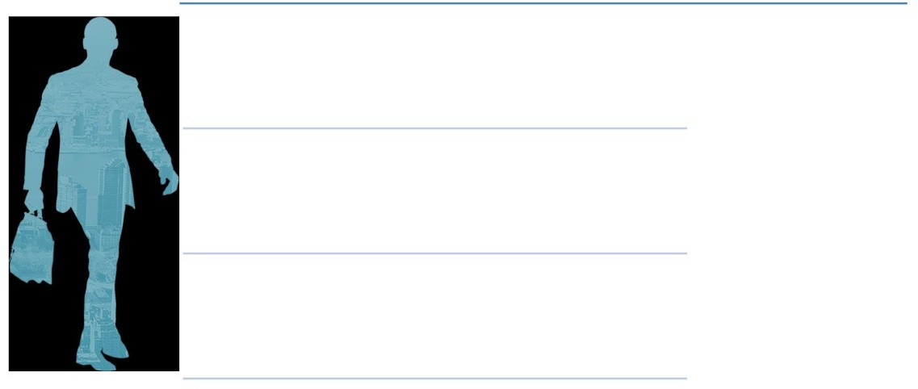
Survey Objective
The Eurofins has engaged People Business to conduct an employee engagement survey
The model for engagement measurement comprises NPS and eNPS with Overall Factors of Pride-Advocacy-Loyalty-Overall Satisfaction and 10 distinct aspects of workplace realities (Workplace Dimensions) that has been measured through an online administered survey
Based on the feedback collected from the survey, set of actions will be taken by the organization to further improve Employee Engagement at the workplace.

Slide 4

Approach taken for Eurofins Engagement Survey 2021
Survey Analysis & Presentation
Survey Launch
We are ere
Before launch of the survey, there was a communication shared with the employees about the survey. The
Customized Questionnaire
Discovery Discussion
There were Leadership discussions done by PB, with Top Management and BU/Functional
Heads and FGD’s with employees at the 4 levels in the organization across functions to understand typical areas that can be surveyed
Basis the discussions, customized questions were recommended by
PB and signed-off by Eurofins
online survey was
launched on November 18, 2019

Slide 5
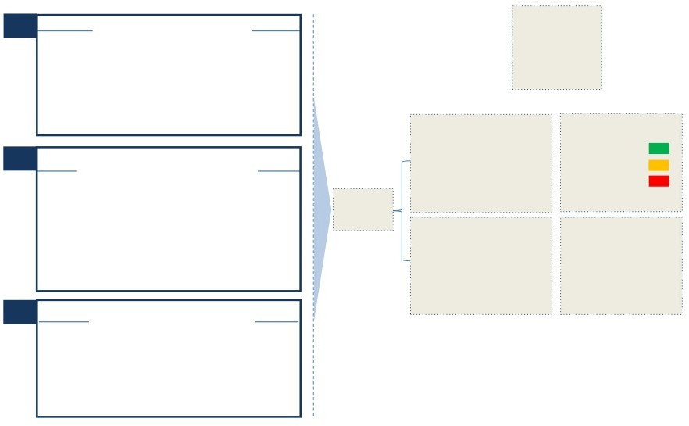
Survey Instrument Design & Scale
Total Number of Questions:
60
Employees perception on the dimensions which create engagement at work as indicated by the eNPS model
Dimensions
5: Strongly Agree
4: Agree
3: Neither Agree nor Disagree
2: Disagree
1: Strongly Disagree
Average Ratings
> 4.0
2.0 - 3.99
< 2.0
Employees assessment of their overall
satisfaction, willingness to advocate with a sense of pride and continue
working at Eurofins
Scale Used
Employee/ Product Advocacy
Overall Measures / Employee Engagement
0 - 10
9 - 10: Promoters
7 - 8: Passives
0 - 6: Detractors
A breakup of Promoter, Passive & Detractor employees based on their responses

Slide 6

Survey Design: NPS and eNPS
Net Product Advocacy Score (NPS) is a ‘employee as a customer’ measurement taken from employees, asking them, how likely are they to recommend the organization’s product or service to others on a scale of 0-10.
eNPS stands for employee Net Promoter Score and is a way for organizations to measure employee loyalty. It measures the likelihood of whether an employee would be willing to recommend the organization as a place to work.
How likely would you be to recommend Eurofins ’s
products / offerings and services to a friend or relative?
How likely would you recommend your organization as a place to work to a friend or relative?
NPS
eNPS
A good NPS score is 10 to 50, while the range is from -100 to 100

Slide 7
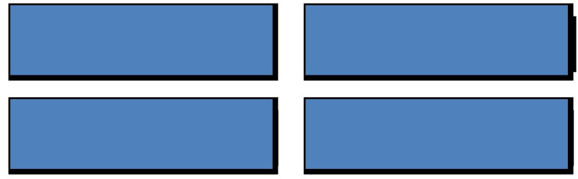
Survey Design: Pride-Advocacy-Loyalty-Overall Satisfaction
• Out of the 36 questions, the following questions measure - Pride,Advocacy,Loyalty,Overall Satisfaction for employees. These questions pertain to aspects of employee experience, which are important to drive engagement at Eurofins .
I would recommend Eurofins to my family and friends, for work
I feel proud to be a part of Eurofins
Two years from now, I see myself continuing to work for Eurofins
I am extremely satisfied with Eurofins as a place to work

Slide 8
Survey Design: Workplace Dimensions
Workplace Dimensions
Details
Communication | Managing Performance
Diversity & Inclusion | Work Conditions
Growth & Development | Innovation
Leadership | Quality Focus
Leadership of Business Ethics | Team Work
Qualitative Questions
Questions
What is the one thing you would want to change about your organization?
What is the one thing you would not want to change about your organization?

Slide 9
Eurofins Survey Participation

Slide 10
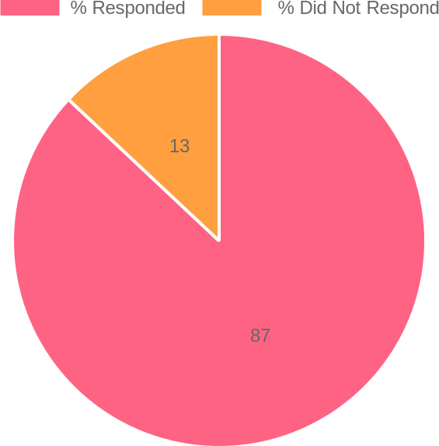
Survey Participation of Eurofins - Overall
Eurofins Overall Participation
 | Target Sample Size | Survey Response | Response Rate
Eurofins Overall | 142 | 124 | 87.00%

Slide 11
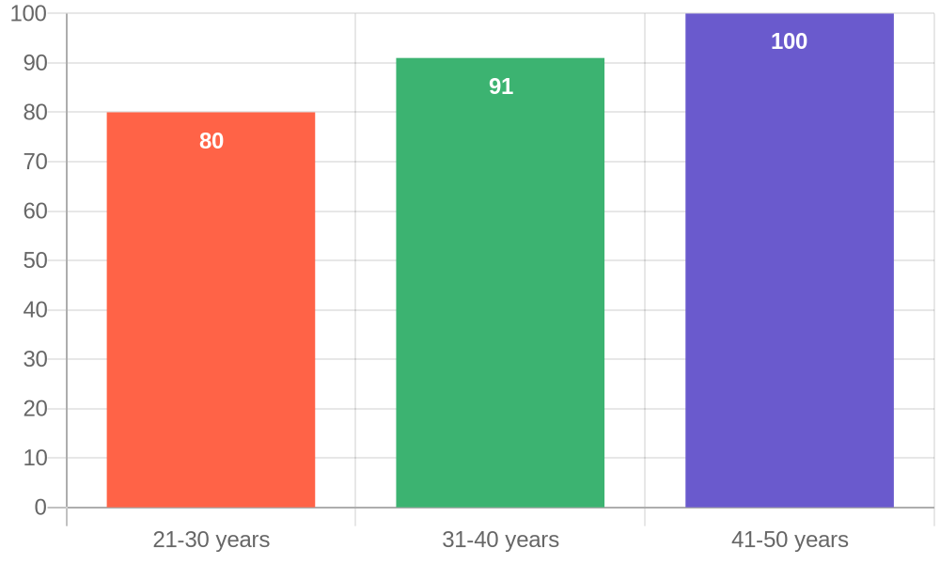
Survey Participation of Eurofins
21-30 years | 43
31-40 years | 70
41-50 years | 11
Fig: Participation rate for different Age Groups

Slide 12
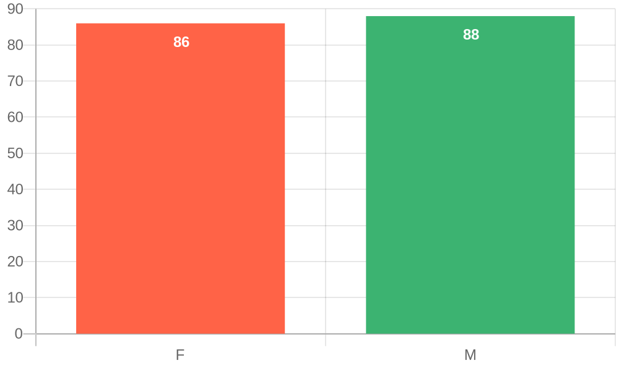
Survey Participation of Eurofins
F | 25
M | 99
Fig: Participation rate for Gender

Slide 13
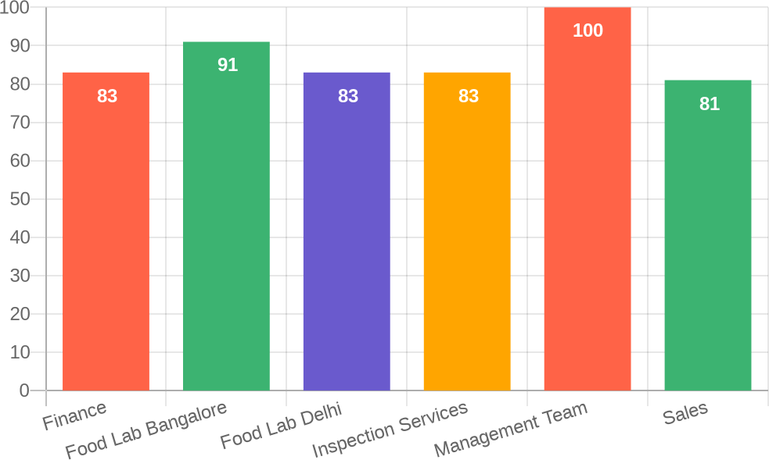
Survey Participation of Eurofins
Finance | 5
Food Lab Bangalore | 72
Food Lab Delhi | 10
Inspection Services | 10
Management Team | 2
Sales | 25
Fig: Participation rate for different Business Unit

Slide 14
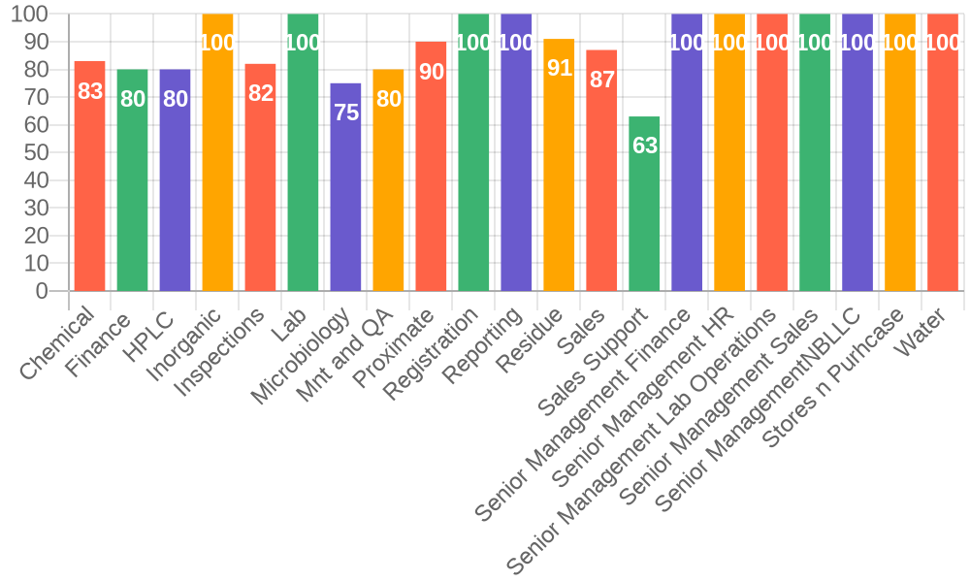
Survey Participation of Eurofins
Chemical | 5
Finance | 4
HPLC | 8
Inorganic | 5
Inspections | 9
Lab | 1
Microbiology | 6
Mnt and QA | 4
Proximate | 9
Registration | 7
Reporting | 9
Residue | 21
Sales | 20
Sales Support | 5
Senior Management Finance | 1
Senior Management HR | 1
Senior Management Lab Operations | 1
Senior Management Sales | 1
Senior ManagementNBLLC | 1
Stores n Purhcase | 1
Water
5
Fig: Participation rate for different Divisions

Slide 15
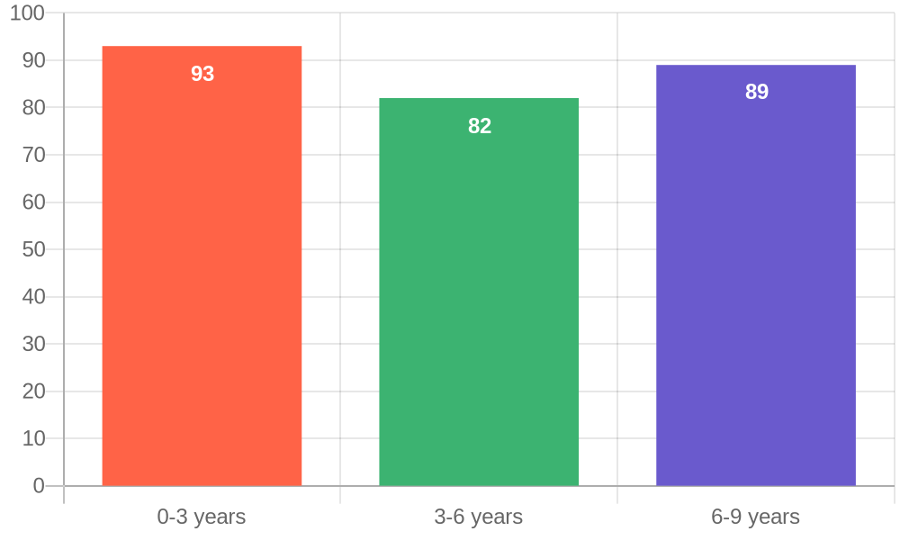
Survey Participation of Eurofins
0-3 years | 65
3-6 years | 51
6-9 years | 8
Fig: Participation rate according to Tenure

Slide 16
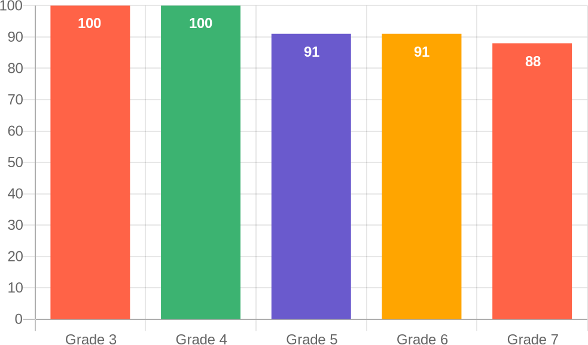
Survey Participation of Eurofins
Grade 3 | 1
Grade 4 | 3
Grade 5 | 10
Grade 6 | 29
Grade 7 | 81
Fig: Participation rate Grade wise

Slide 17
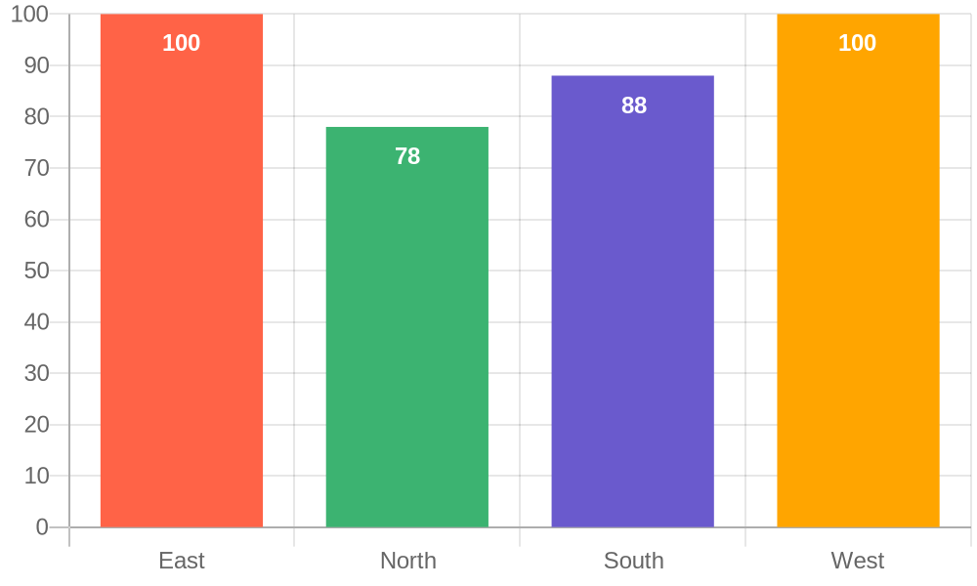
Survey Participation of Eurofins
East | 3
North | 14
South | 103
West | 4
Fig: Participation rate Region wise

Slide 18
Analysis of
Pride-Advocacy-Loyalty-Overall Satisfaction

Slide 19
Key Insights
Pride
Loyalty
• 90% of employees are proud of working with the Company Name . This isorganization
• The sense of continuing in the organization for next 2 years is highest in
Advocacy
Satisfaction
• The sense of recommending the organization as a place of work, is highest
• The

Slide 20
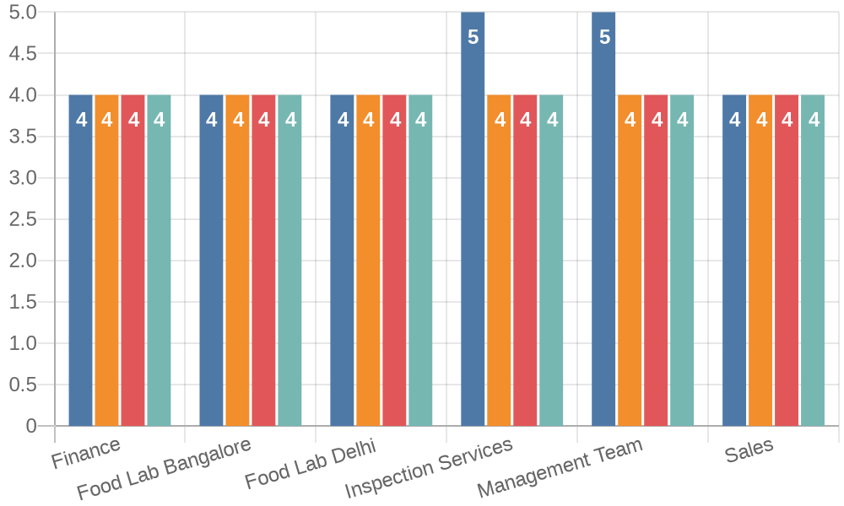
Overall Dimensions – Business Unit
Base | 10 | 72 | 25 | 10 | 5 | 2

Slide 21
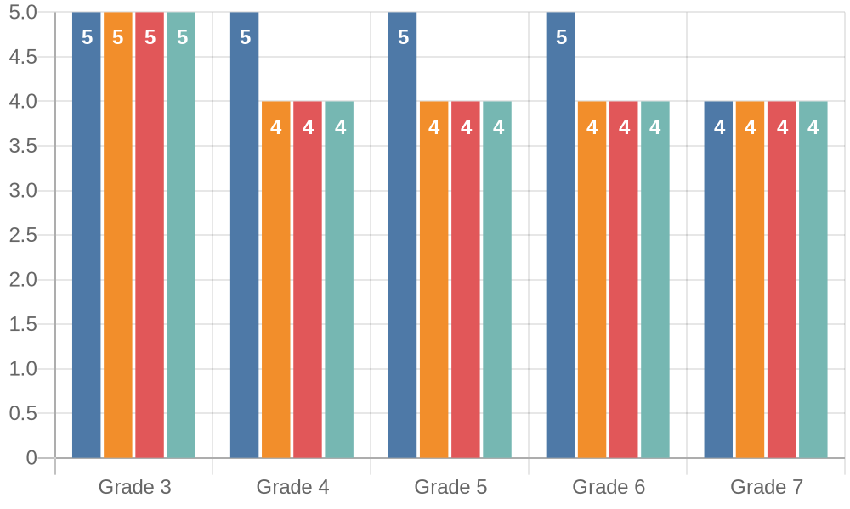
Overall Dimensions – Grade
Base | 29 | 10 | 3 | 81 | 1

Slide 22
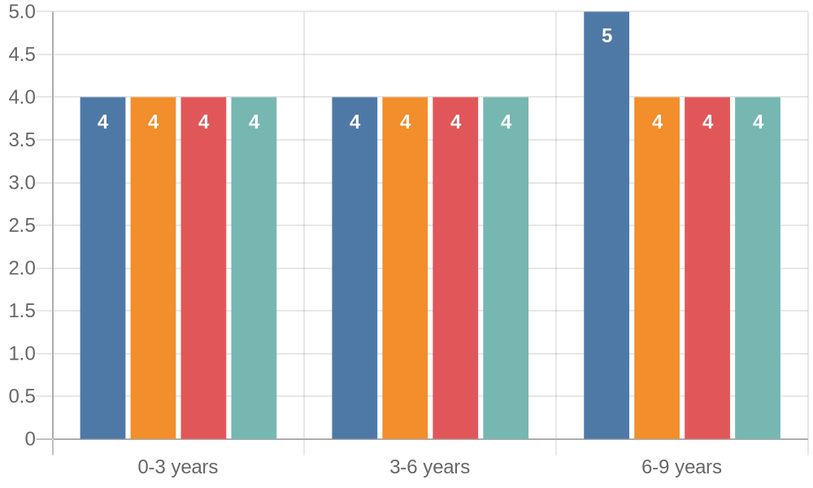
Overall Dimensions – Tenure
Base | 8 | 51 | 65

Slide 23
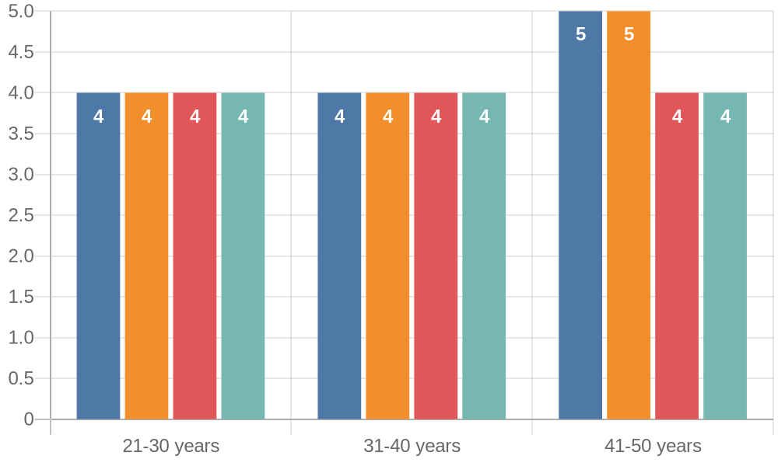
Overall Dimensions – Age
Base | 11 | 70 | 43

Slide 24
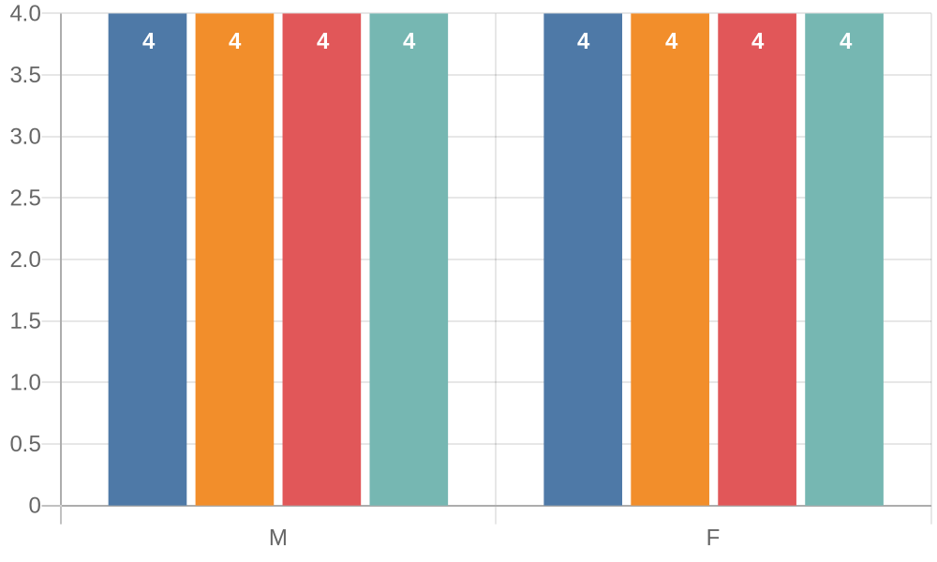
Overall Dimensions – Age
Base
99
25

Slide 25
Top 5 and Bottom 5 Questions
Question | Dimension | Avg. Rating | (Rating 4/5) % | (Rating 1/2/3) %
I feel proud to be a part of Eurofins | Pride | 4.25 | 95% | 5%
At Eurofins people are treated fairly regardless of their race or caste | Diversity & Inclusion | 4.13 | 90% | 10%
Integrity of data that I generate is critical for the success of the organization | Leadership of Business Ethics | 4.19 | 92% | 8%
Eurofins is committed to providing high-quality service to its customers | Quality Focus | 4.24 | 95% | 5%
My team helps me operate at my best | Team Work | 4.24 | 94% | 6%
Question | Dimension | Avg. Rating | (Rating 4/5) % | (Rating 1/2/3) %
I believe that the leadership communicates effectively with the rest of the organization | Communication | 3.70 | 70% | 30%
At Eurofins, promotions go to those who best deserve them | Growth & Development | 3.66 | 69% | 31%
In the past 1 year, there has been positive changes in Eurofins | Leadership | 3.13 | 48% | 52%
I am satisfied with the speed of decision making in Eurofins | Leadership | 3.44 | 60% | 40%
High performance is adequately rewarded at Eurofins | Managing Performance | 3.56 | 65% | 35%

Slide 26
Overall Dimension Questions – Q1 to Q6
Dimension Questions | Dimension | Strongly Disagree % | Disagree % | Neither Agree nor Disagree % | Agree % | Strongly Agree % | Agreeing % | Not Agreeing % | Eurofins Overall
Q1) I feel proud to be a part of Eurofins | Pride | 1.61 | 1.61 | 1.61 | 60.48 | 34.68 | 95.16 | 4.84 | 4.25
Q2) I will recommend Eurofins as a great place to work | Advocacy | 3.23 | 7.26 | 8.06 | 61.29 | 20.16 | 81.45 | 18.55 | 3.88
Q3) Two years from now, I see myself continuing to work for Eurofins | Loyalty | 0.81 | 4.03 | 16.94 | 54.84 | 23.39 | 78.23 | 21.77 | 3.96
Q4) I am extremely satisfied with Eurofins as a place to work | Overall Satisfaction | 0.81 | 12.10 | 9.68 | 62.10 | 15.32 | 77.42 | 22.58 | 3.79
Q5) My manager communicates the organization's goals to me | Communication | 1.61 | 6.45 | 8.87 | 60.48 | 22.58 | 83.06 | 16.94 | 3.96
Q6) My manager listens to my ideas, opinions and concerns | Communication | 0.81 | 8.06 | 15.32 | 47.58 | 28.23 | 75.81 | 24.19 | 3.94

Slide 27
Overall Dimension Questions – Q7 to Q12
Dimension Questions | Dimension | Strongly Disagree % | Disagree % | Neither Agree nor Disagree % | Agree % | Strongly Agree % | Agreeing % | Not Agreeing % | Eurofins Overall
Q7) I believe that the leadership communicates effectively with the rest of the organization | Communication | 1.61 | 8.06 | 20.16 | 58.87 | 11.29 | 70.16 | 29.84 | 3.70
Q8) At Eurofins people are treated fairly regardless of their age | Diversity & Inclusion | 0.81 | 4.03 | 6.45 | 70.16 | 18.55 | 88.71 | 11.29 | 4.02
Q9) At Eurofins people are treated fairly regardless of their race or caste | Diversity & Inclusion |  | 4.03 | 5.65 | 63.71 | 26.61 | 90.32 | 9.68 | 4.13
Q10) At Eurofins people are treated fairly regardless of their sex | Diversity & Inclusion | 1.61 | 4.84 | 7.26 | 65.32 | 20.97 | 86.29 | 13.71 | 3.99
Q11) If I am unfairly treated, I believe I'll be given a fair hearing if I appeal. | Diversity & Inclusion | 0.81 | 4.03 | 15.32 | 62.90 | 16.94 | 79.84 | 20.16 | 3.91
Q12) At Eurofins, I have received adequate training necessary to do my job well | Growth & Development | 1.61 | 8.06 | 11.29 | 60.48 | 18.55 | 79.03 | 20.97 | 3.86

Slide 28
Overall Dimension Questions – Q13 to Q18
Dimension Questions | Dimension | Strongly Disagree % | Disagree % | Neither Agree nor Disagree % | Agree % | Strongly Agree % | Agreeing % | Not Agreeing % | Eurofins Overall
Q13) My manager coaches me to build my skills | Growth & Development | 0.81 | 10.48 | 8.06 | 58.06 | 22.58 | 80.65 | 19.35 | 3.91
Q14) My manager supports my growth and development in my current role | Growth & Development | 1.61 | 6.45 | 10.48 | 56.45 | 25.00 | 81.45 | 18.55 | 3.97
Q15) I believe that I have adequate opportunities for growth in my organization | Growth & Development |  | 10.48 | 14.52 | 59.68 | 15.32 | 75.00 | 25.00 | 3.80
Q16) At Eurofins, promotions go to those who best deserve them | Growth & Development | 1.61 | 10.48 | 19.35 | 57.26 | 11.29 | 68.55 | 31.45 | 3.66
Q17) I have full confidence in our leaders’ decisions and direction | Leadership | 2.42 | 6.45 | 15.32 | 62.90 | 12.90 | 75.81 | 24.19 | 3.77
Q18) In the past 1 year, there has been positive changes in Eurofins | Leadership | 14.52 | 16.13 | 21.77 | 37.10 | 10.48 | 47.58 | 52.42 | 3.13

Slide 29
Overall Dimension Questions – Q19 to Q24
Dimension Questions | Dimension | Strongly Disagree % | Disagree % | Neither Agree nor Disagree % | Agree % | Strongly Agree % | Agreeing % | Not Agreeing % | Eurofins Overall
Q19) I am satisfied with the speed of decision making in Eurofins | Leadership | 5.65 | 17.74 | 16.13 | 47.58 | 12.90 | 60.48 | 39.52 | 3.44
Q20) I feel connected with the vision of my organization | Leadership | 2.42 | 5.65 | 16.13 | 60.48 | 15.32 | 75.81 | 24.19 | 3.81
Q21) The organization has made available policies related to ethics/code of conduct to employees and provided training | Leadership of Business Ethics | 0.81 | 4.03 | 7.26 | 62.90 | 25.00 | 87.90 | 12.10 | 4.07
Q22) Integrity of data that I generate is critical for the success of the organization | Leadership of Business Ethics |  | 0.81 | 7.26 | 64.52 | 27.42 | 91.94 | 8.06 | 4.19
Q23) I strongly believe that the organization encourages everyone to comply with the ethical practices and organizational policies | Leadership of Business Ethics |  | 3.23 | 7.26 | 68.55 | 20.97 | 89.52 | 10.48 | 4.07
Q24) The organization has mechanism to report any actual or possible ethical violations | Leadership of Business Ethics | 0.81 | 4.84 | 4.84 | 73.39 | 16.13 | 89.52 | 10.48 | 3.99

Slide 30
Overall Dimension Questions – Q25 to Q30
Dimension Questions | Dimension | Strongly Disagree % | Disagree % | Neither Agree nor Disagree % | Agree % | Strongly Agree % | Agreeing % | Not Agreeing % | Eurofins Overall
Q25) Senior leadership is involved in spreading awareness and understanding of the TCoC | Leadership of Business Ethics | 1.61 | 5.65 | 17.74 | 62.90 | 12.10 | 75.00 | 25.00 | 3.78
Q26) My manager gives me feedback on my job performance | Managing Performance | 2.42 | 6.45 | 6.45 | 62.90 | 21.77 | 84.68 | 15.32 | 3.95
Q27) High performance is adequately rewarded at Eurofins | Managing Performance | 4.03 | 9.68 | 21.77 | 54.84 | 9.68 | 64.52 | 35.48 | 3.56
Q28) My successes are recognized by my manager and co- workers | Managing Performance | 4.03 | 8.06 | 14.52 | 53.23 | 20.16 | 73.39 | 26.61 | 3.77
Q29) I am given the necessary authority to carry out my work effectively | Managing Performance | 0.81 | 2.42 | 5.65 | 70.97 | 20.16 | 91.13 | 8.87 | 4.07
Q30) Managers treat all team members equally | Managing Performance | 3.23 | 4.84 | 12.10 | 56.45 | 23.39 | 79.84 | 20.16 | 3.92

Slide 31
Overall Dimension Questions – Q31 to Q36
Dimension Questions | Dimension | Strongly Disagree % | Disagree % | Neither Agree nor Disagree % | Agree % | Strongly Agree % | Agreeing % | Not Agreeing % | Eurofins Overall
Q31) Eurofins ensures healthy and safe working conditions | Work Conditions | 4.84 | 8.87 | 4.84 | 62.90 | 18.55 | 81.45 | 18.55 | 3.81
Q32) I have access to all the necessary facilities to work effectively at my office | Work Conditions | 4.03 | 6.45 | 4.84 | 65.32 | 19.35 | 84.68 | 15.32 | 3.90
Q33) I feel encouraged to come up with new and better ways of doing things | Innovation | 2.42 | 5.65 | 8.87 | 68.55 | 14.52 | 83.06 | 16.94 | 3.87
Q34) Eurofins is committed to providing high-quality service to its customers | Quality Focus |  | 2.42 | 2.42 | 63.71 | 31.45 | 95.16 | 4.84 | 4.24
Q35) My team helps me operate at my best | Team Work |  | 0.81 | 5.65 | 62.10 | 31.45 | 93.55 | 6.45 | 4.24
Q36) There is good teamwork and cooperation between departments/teams at Eurofins | Team Work | 1.61 | 5.65 | 8.06 | 57.26 | 27.42 | 84.68 | 15.32 | 4.03

Slide 32
Eurofins Workplace Dimensions

Slide 33
Workplace Dimensions Business Unit - Overall (N = 124)
Avg Scores
Communication
1% 8%
1% 4%
1% 9%
6%
15%
56%
21%
3.87
4.01
3.84
3.54
4.02
3.86
3.85
3.87
4.24
4.14
Diversity & Inclusion
9%
66%
21%
Growth & Development
13%
58%
19%
Leadership
11%
17%
52%
13%
Leadership of Business Ethics | 1% |  | 4% |  |  |  | 9% |  |  |  | 66% |  |  |  |  | 20%
Managing Performance | 3% |  | 6% |  |  |  |  |  | 12% |  | 60% |  |  |  |  | 19%
Work Conditions | 4% |  |  | 8% |  |  |  | 5% |  | 64% |  |  |  |  | 19%
Innovation | 2% | 6% |  |  |  |  | 9% |  | 69% |  |  |  |  |  | 15%
Quality Focus | 2% |  | 2% |  |  |  |  |  |  |  | 64% |  |  |  | 31%
Team Work | 1% |  | 3% |  |  |  | % |  | 60% |  |  |  |  |  | 29%
7
Strongly Disagree
Disagree
Neither Agree or Disagree Agree
Strongly Agree

Slide 34
Workplace Dimensions Business Unit 1 - Finance (N = 5)
Avg Scores
Communication
Diversity & Inclusion Growth & Development Leadership
Leadership of Business Ethics Managing Performance Work Conditions
Innovation Quality Focus Team Work
20% |  |  |  |  |  | 20% |  |  | 60%
10% |  |  | 5% |  | 25% |  |  |  | 40% |  |  |  |  | 20%
4% 8% 12% 40% 36%
15% |  |  |  |  | 15% |  |  | 25% |  |  | 25% |  |  | 20%
4%
 | 8% |  |  | 12% |  |  | 56% |  |  |  |  |  |  | 20%
8% |  | 4% |  | 8% |  | 32% |  |  |  | 48%
20% |  |  |  |  |  | 10% |  | 50% |  |  |  |  |  | 20%
80% |  |  |  |  |  |  |  |  |  |  |  |  |  | 20%
60% |  |  |  |  |  |  |  |  |  |  |  | 40%
20% |  |  |  |  |  | 50% |  |  |  |  |  |  | 30%
4.40
3.55
3.96
3.20
3.80
4.08
3.70
4.20
4.40
4.10
Strongly Disagree
Disagree
Neither Agree or Disagree
Agree Strongly Agree

Slide 35
Workplace Dimensions Business Unit 2 - Food Lab Bangalore
(N = 72)
Avg Scores
Communication
Diversity & Inclusion Growth & Development Leadership
Leadership of Business Ethics Managing Performance Work Conditions
Innovation Quality Focus Team Work
2% 11% 14% 61% 13%
5% |  | 7% |  |  | 74% |  |  |  |  |  | 14%
1% 11% 13% 62% 13%
8% |  |  |  | 15% |  |  |  |  | 16% | 55% |  |  | 6%
1% 4% 10% 73% 12% 4% 8% 13% 63% 13%
6% |  |  | 10% |  |  |  | 5% | 69% |  |  |  | 10%
4%
 | 10% |  |  |  |  | 7% |  | 69% |  |  |  | 10%
1% 4% 71% 24% 4% 5% 65% 26%
3.71
3.97
3.75
3.36
3.92
3.72
3.67
3.71
4.17
4.13
Strongly Disagree
Disagree
Neither Agree or Disagree
Agree Strongly Agree

Slide 36
Workplace Dimensions Business Unit 3 - Food Lab Delhi (N = 10)
Avg Scores
Communication
Diversity & Inclusion Growth & Development Leadership
Leadership of Business Ethics Managing Performance Work Conditions
Innovation Quality Focus Team Work
10% |  |  | 60% |  | 30%
3% 3% 4% |  | 6% | 73% 60% |  |  |  | 23% 30%
75% |  |  |  |  |  | 25%
66% |  |  |  | 34%
2% 4% |  |  | 66% |  |  |  | 28%
70% |  |  |  |  | 30%
10% |  |  | 70% |  |  |  | 20%
70% |  |  |  |  | 30%
5% | 65% |  |  |  | 30%
4.20
4.15
4.16
4.25
4.34
4.20
4.30
4.10
4.30
4.25
Strongly Disagree
Disagree
Neither Agree or Disagree
Agree Strongly Agree

Slide 37
Workplace Dimensions Business Unit 4 - Inspection Services
(N = 10)
Avg Scores
Communication
Diversity & Inclusion Growth & Development Leadership
Leadership of Business Ethics Managing Performance Work Conditions
Innovation Quality Focus Team Work
3% 7% 27% 60% 3%
5% | 20% |  |  |  |  |  | 58% |  |  |  | 18%
 |  | 4% 8% 74% 8%
6%
8% |  |  | 13% |  |  | 23% |  | 48% |  |  |  | 10%
2% 10% 8% 58% 22% 4% 2% 12% 68% 14%
10% |  |  |  | 5% | 60% |  |  |  |  | 25%
90% |  |  |  |  |  |  |  |  |  |  |  | 10%
20% |  |  |  |  |  | 80%
60% |  |  |  |  |  |  |  |  | 40%
3.53
3.83
3.74
3.40
3.88
3.86
3.85
4.10
4.80
4.40
Strongly Disagree
Disagree
Neither Agree or Disagree
Agree Strongly Agree

Slide 38
Workplace Dimensions Business Unit 5 - Management Team
(N = 2)
Avg Scores
Communication
Diversity & Inclusion Growth & Development Leadership
Leadership of Business Ethics Managing Performance Work Conditions
Innovation Quality Focus Team Work
33% |  |  |  | 17% |  | 50%
13% | 38% |  |  |  |  | 50%
50% |  |  |  |  |  | 50%
13% | 13% |  | 25% |  |  | 50%
60% |  |  |  |  |  |  | 40%
20% |  | 20% |  |  | 40% |  |  | 20%
25% |  |  | 75%
50% |  |  |  |  |  | 50%
50% |  |  |  |  |  | 50%
25% |  |  | 75%
4.17
4.38
4.00
4.13
4.40
3.60
4.75
4.00
4.50
4.50
Strongly Disagree
Disagree
Neither Agree or Disagree
Agree Strongly Agree

Slide 39
Workplace Dimensions Business Unit 6 - Sales (N = 25)
Avg Scores
Communication
Diversity & Inclusion Growth & Development Leadership
Leadership of Business Ethics Managing Performance Work Conditions
Innovation Quality Focus Team Work
3% 12% 48% 37%
5% |  | 8% |  |  |  | 48% |  |  |  |  | 39%
8% |  |  | 14% |  |  |  |  |  |  | 49% |  |  |  |  |  | 29%
3% 4% 24% 43% 26%
10% |  |  |  | 54% |  |  |  |  |  |  |  | 36%
4% | 14% |  |  |  |  |  |  | 52% |  |  |  |  |  |  | 30%
4% | 8% |  |  |  | 54% |  |  |  |  |  |  |  | 34%
16% |  |  |  |  |  |  | 60% |  |  |  |  |  |  |  |  |  | 24%
8% |  |  | 60% |  |  |  |  |  |  |  |  |  |  | 32%
4%
 | 4% |  | 12% |  |  |  |  |  | 50% |  |  |  |  |  | 30%
4.20
4.21
3.98
3.85
4.26
4.09
4.18
4.08
4.16
3.98
Strongly Disagree
Disagree
Neither Agree or Disagree
Agree Strongly Agree

Slide 40
Workplace Dimensions Division 1 - Chemical (N = 5)
Avg Scores
Communication
Diversity & Inclusion Growth & Development Leadership
Leadership of Business Ethics Managing Performance Work Conditions
Innovation Quality Focus Team Work
20% |  |  |  |  | 40% |  | 40%
5% | 5% |  | 65% |  |  |  |  |  | 25%
8% |  | 8% |  | 44% |  |  | 40%
70% |  |  |  |  |  |  |  | 30%
52% |  |  |  |  |  | 48%
4% 8% 52% 36%
60% |  |  |  |  |  |  | 40%
20% |  |  |  |  | 60% |  |  |  |  | 20%
60% |  |  |  |  |  |  | 40%
10% |  |  | 50% |  |  |  | 40%
4.20
4.10
4.16
4.30
4.48
4.20
4.40
4.00
4.40
4.30
Strongly Disagree
Disagree
Neither Agree or Disagree
Agree Strongly Agree

Slide 41
Workplace Dimensions Division 2 - Finance
(N = 4)
Avg Scores
Communication
Diversity & Inclusion Growth & Development Leadership
Leadership of Business Ethics Managing Performance Work Conditions
Innovation Quality Focus Team Work
25% |  |  |  |  |  |  |  | 17% |  | 58%
6% |  | 25% |  |  |  |  |  |  | 44% |  |  |  |  |  | 25%
10% |  |  | 10% |  |  |  | 40% |  |  |  |  |  | 40%
6% |  | 13% |  |  |  | 25% |  |  |  |  | 31% |  |  |  | 25%
10% |  |  | 65% |  |  |  |  |  |  |  |  |  |  |  | 25%
5% | 10% |  |  |  | 35% |  |  |  |  |  |  | 50%
13% |  |  |  | 63% |  |  |  |  |  |  |  |  |  |  | 25%
75% |  |  |  |  |  |  |  |  |  |  |  |  |  |  | 25%
75% |  |  |  |  |  |  |  |  |  |  |  |  |  |  | 25%
25% |  |  |  |  |  |  |  | 38% |  |  |  |  |  | 38%
4.33
3.88
4.10
3.56
4.15
4.30
4.13
4.25
4.25
4.13
Strongly Disagree
Disagree
Neither Agree or Disagree
Agree Strongly Agree

Slide 42
Workplace Dimensions Division 3 - HPLC
(N = 8)
Avg Scores
Communication
4%
79%
17%
4.13
4.13
4.23
4.06
4.15
4.18
4.06
4.00
4.25
4.31
Diversity & Inclusion
3%
78%
19%
Growth & Development
3%
73%
25%
Leadership
3%
88%
9%
Leadership of Business Ethics
85%
15%
Managing Performance | 5% |  |  | 73% |  |  |  |  | 23%
Work Conditions |  |  |  |  | 94% |  |  |  |  | 6%
Innovation |  |  |  |  | 100%
Quality Focus |  |  | 75% |  |  |  |  |  | 25%
Team Work |  | 69% |  |  |  |  |  | 31%
Strongly Disagree Disagree Neither Agree or Disagree
Agree Strongly Agree

Slide 43
Workplace Dimensions Division 4 - Inorganic (N = 5)
Avg Scores
Communication
Diversity & Inclusion Growth & Development Leadership
Leadership of Business Ethics Managing Performance Work Conditions
Innovation Quality Focus Team Work
20% |  |  |  | 20% |  |  |  |  | 60%
100%
12% |  |  | 8% | 16% |  |  |  | 48% |  |  |  | 16%
10% |  | 15% |  |  | 10% |  | 60% |  |  |  |  |  | 5%
4% | 76% |  |  |  |  |  |  |  |  |  | 20%
4% | 8% |  | 16% |  |  | 56% |  |  |  |  |  | 16%
10% |  | 10% |  | 20% |  |  |  |  | 60%
20% |  |  |  | 60% |  |  |  |  |  |  | 20%
20% |  |  |  | 20% |  |  |  |  | 60%
50% |  |  |  |  |  |  |  |  |  | 50%
3.40
4.00
3.48
3.35
4.12
3.72
3.30
4.00
4.40
4.50
Strongly Disagree
Disagree
Neither Agree or Disagree
Agree Strongly Agree

Slide 44
Workplace Dimensions Division 5 - Inspections (N = 9)
Avg Scores
Communication
4%
7%
26%
59%
4%
3.52
3.81
3.78
3.42
4.04
3.80
3.78
4.11
4.89
4.39
Diversity & Inclusion
6%
22%
53%
19%
Growth & Development
4% 4%
9%
73%
9%
Leadership
8%
11%
22%
47%
11%
Leadership of Business Ethics | 2% | 4% | 4% |  |  | 64% |  |  |  | 24%
Managing Performance | 4% | 2% |  | 13% |  |  |  | 69% |  |  | 11%
Work Conditions |  | 11% |  | 6% |  |  | 61% |  |  | 22%
Innovation
89%
11%
Quality Focus
11%
89%
Team Work
61%
39%
Strongly Disagree
Disagree
Neither Agree or Disagree
Agree
Strongly Agree

Slide 45
Workplace Dimensions Division 6 - Lab
(N = 1)
Avg Scores
Communication
100%
4.00
4.00
4.00
4.00
4.00
4.00
4.00
4.00
4.00
4.00
Diversity & Inclusion
100%
Growth & Development
100%
Leadership
100%
Leadership of Business Ethics
100%
Managing Performance
100%
Work Conditions
100%
Innovation
100%
Quality Focus
100%
Team Work
100%
Strongly Disagree
Disagree
Neither Agree or Disagree
Agree Strongly Agree

Slide 46
Workplace Dimensions Division 7 - Microbiology (N = 6)
Avg Scores
Communication
Diversity & Inclusion Growth & Development Leadership
Leadership of Business Ethics Managing Performance Work Conditions
Innovation Quality Focus Team Work
6% | 11% |  |  | 72% |  |  |  |  |  |  | 11%
83% |  |  |  |  |  |  |  |  | 17%
7% |  | 17% |  |  |  | 67% |  |  |  |  |  | 10%
 |  |  |  |  |  |  |  |  |  |  |  |  | 4%
21% |  |  |  |  | 21% |  | 54%
13% |  |  | 73% |  |  |  |  |  |  | 13%
3% | 7% |  | 13% |  |  |  | 70% |  |  |  |  | 7%
83% |  |  |  |  |  |  |  |  | 17%
83% |  |  |  |  |  |  |  |  | 17%
83% |  |  |  |  |  |  |  |  | 17%
67% |  |  |  |  |  |  |  | 33%
3.89
4.17
3.80
3.42
4.00
3.70
4.17
4.17
4.17
4.33
Strongly Disagree
Disagree
Neither Agree or Disagree
Agree Strongly Agree

Slide 47
Workplace Dimensions Division 8 - Mnt & QA (N = 4)
Avg Scores
Communication
Diversity & Inclusion Growth & Development Leadership
Leadership of Business Ethics Managing Performance Work Conditions
Innovation Quality Focus Team Work
8% |  |  | 50% |  |  |  |  |  |  |  | 17% |  | 25%
6% |  | 63% |  |  |  |  |  |  |  |  |  | 31%
25% |  |  |  |  |  | 20% |  |  | 35% |  |  |  |  | 20%
6% |  | 25% |  |  |  |  | 19% |  |  | 50%
5% | 75% |  |  |  |  |  |  |  |  |  |  |  |  | 20%
5% | 15% |  |  |  | 15% |  |  | 45% |  |  |  |  |  | 20%
13% |  |  |  | 13% |  | 50% |  |  |  |  |  |  | 25%
25% |  |  |  |  |  | 25% |  |  |  | 50%
100%
13% |  |  |  | 13% |  | 75%
3.58
4.25
3.50
3.13
4.15
3.60
3.88
3.00
4.00
3.63
Strongly Disagree
Disagree
Neither Agree or Disagree
Agree Strongly Agree

Slide 48
Workplace Dimensions Division 9 - Proximate (N = 9)
Avg Scores
Communication
Diversity & Inclusion Growth & Development Leadership
Leadership of Business Ethics Managing Performance Work Conditions
Innovation Quality Focus Team Work
19% |  |  |  |  |  |  | 7% | 67% |  |  |  |  |  |  |  |  |  | 7%
6% | 25% |  |  |  |  |  |  |  | 58% |  |  |  |  |  |  | 11%
16% |  |  |  |  | 22% |  |  |  |  |  | 53% |  |  |  |  |  | 9%
 |  |  |  |  |  |  |  |  |  |  |  |  |  |  |  |  |  |  | 3%
8% |  | 28% |  |  |  |  |  |  |  | 14% |  | 47%
13% |  |  |  | 73% |  |  |  |  |  |  |  |  |  |  | 13%
2% 9% 20% 64% 4%
11% |  |  | 6% |  |  | 67% |  |  |  |  |  |  |  | 17%
11% |  |  | 89%
100%
6% | 72% |  |  |  |  |  |  |  |  |  |  |  | 22%
3.63
3.75
3.56
3.08
4.00
3.60
3.72
3.78
4.00
4.11
Strongly Disagree
Disagree
Neither Agree or Disagree
Agree Strongly Agree

Slide 49
Workplace Dimensions Division 10 - Registration (N = 7)
Avg Scores
Communication
Diversity & Inclusion Growth & Development Leadership
Leadership of Business Ethics Managing Performance Work Conditions
Innovation Quality Focus Team Work
10% |  |  |  | 76% |  |  |  |  | 14%
14% |  |  |  |  |  | 75% |  |  |  | 11%
6% | 6% |  |  |  | 80% |  |  |  |  |  | 9%
14% |  |  |  |  |  | 7% | 64% |  | 14%
6% | 89% |  |  |  |  |  |  |  |  |  |  |  | 6%
9% |  |  | 6% |  |  | 80% |  |  |  |  |  |  | 6%
7% |  | 7% |  |  |  | 79% |  |  |  |  |  | 7%
14% |  |  |  |  |  | 14% |  | 71%
86% |  |  |  |  |  |  |  |  | 14%
100%
4.05
3.82
3.91
3.79
4.00
3.83
3.86
3.57
4.14
4.00
Strongly Disagree
Disagree
Neither Agree or Disagree
Agree Strongly Agree

Slide 50
Workplace Dimensions Division 11 - Reporting (N = 9)
Avg Scores
Communication
Diversity & Inclusion Growth & Development Leadership
Leadership of Business Ethics Managing Performance Work Conditions
Innovation Quality Focus Team Work
7% |  | 19% |  |  |  |  |  |  |  | 7% |  |  |  | 33% |  |  |  |  |  | 33%
6% | 8% |  |  | 50% |  |  |  |  |  |  |  |  |  |  |  |  |  |  | 36%
16% |  |  |  |  | 13% |  |  |  |  |  |  | 33% |  |  |  |  |  | 38%
25% |  |  |  |  |  |  |  |  | 11% |  |  |  |  |  | 25% |  | 19% |  |  |  | 19%
2% | 16% |  |  |  |  |  |  | 11% |  |  |  |  |  |  | 38% |  |  |  |  |  | 33%
16% |  |  |  |  | 4% |  | 11% |  |  |  |  |  | 27% |  |  | 42%
17% |  |  |  |  |  | 11% |  |  |  |  | 6% |  |  | 33% |  |  |  |  |  | 33%
11% |  |  | 11% |  |  |  |  | 11% |  |  |  |  |  | 33% |  |  |  |  |  | 33%
33% |  |  |  |  |  |  |  |  |  |  |  |  |  | 67%
11% |  |  | 17% |  |  |  |  |  |  |  | 72%
3.67
4.17
3.93
2.97
3.84
3.76
3.56
3.67
4.67
4.50
Strongly Disagree
Disagree
Neither Agree or Disagree
Agree Strongly Agree

Slide 51
Workplace Dimensions Division 12 - Residue (N = 21)
Avg Scores
Communication
3%
14%
16%
62%
5%
3.51
3.86
3.57
3.25
3.73
3.60
3.38
3.52
3.95
4.00
Diversity & Inclusion
6%
8%
80%
6%
Growth & Development
15%
13%
70%
1%
Leadership
8%
17%
20%
51%
4%
Leadership of Business Ethics
1%
8% | 15% |  | 70% |  |  | 7%
11% |  | 14% |  | 66% | 6%
Managing Performance
3%
Work Conditions
7%
19%
5%
67%
2%
Innovation
5%
19%
5%
62%
10%
Quality Focus
5%
10%
71%
14%
Team Work
5%
12%
62%
21%
Strongly Disagree
Disagree
Neither Agree or Disagree
Agree Strongly Agree

Slide 52
Workplace Dimensions Division 13 - Sales
(N = 20)
Avg Scores
Communication
3%
10%
43%
43%
4.27
4.24
4.08
3.95
4.24
4.23
4.23
4.15
4.20
4.05
Diversity & Inclusion
5% 6%
49%
40%
Growth & Development | 1% | 6% |  |  | 10% |  | 50% |  |  | 33%
Leadership | 3% | 4% |  | 20% |  |  |  | 44% |  | 30%
Leadership of Business Ethics | 3% |  |  | 11% |  |  |  | 45% |  |  | 41%
Managing Performance | 2% | 10% |  | 51% |  |  |  | 37%
Work Conditions | 5% | 8% |  | 48% |  |  |  | 40%
Innovation | 10% |  |  |  | 65% |  |  |  | 25%
Quality Focus | 10% |  |  | 50% |  |  |  | 40%
Team Work
5% 3%
13%
43%
38%
Strongly Disagree
Disagree
Neither Agree or Disagree
Agree Strongly Agree

Slide 53
Workplace Dimensions Division 14 - Sales Support (N = 5)
Avg Scores
Communication
Diversity & Inclusion Growth & Development Leadership
Leadership of Business Ethics Managing Performance Work Conditions
Innovation Quality Focus Team Work
27% |  |  |  |  |  |  | 60% |  |  |  |  |  | 13%
5% | 15% |  |  |  |  | 60% |  |  |  |  | 20%
16% |  |  |  |  | 32% |  |  |  | 40% |  |  |  |  | 12%
5% | 10% |  |  | 40% |  |  |  |  |  | 35% |  |  |  |  | 10%
16% |  |  |  |  | 68% |  |  |  |  |  |  | 16%
12% |  |  | 28% |  |  |  |  | 48% |  |  |  |  |  | 12%
10% |  | 70% |  |  |  |  |  |  |  |  | 20%
40% |  |  |  |  |  |  |  | 40% |  |  | 20%
100%
10% |  | 10% |  |  |  | 70% |  |  |  |  |  |  |  |  | 10%
3.87
3.95
3.48
3.35
4.00
3.60
4.10
3.80
4.00
3.80
Strongly Disagree
Disagree
Neither Agree or Disagree
Agree Strongly Agree

Slide 54
Workplace Dimensions
Division 15 - Senior Management Finance (N = 1)
Avg Scores
Communication
Diversity & Inclusion Growth & Development Leadership
Leadership of Business Ethics Managing Performance Work Conditions
Innovation Quality Focus Team Work
33% |  | 67%
50% |  |  |  | 25% |  | 25%
20% | 20% |  | 40% |  |  |  | 20%
50% |  |  |  | 25% |  | 25%
20% | 40% |  |  |  | 20% |  | 20%
40% |  |  | 20% |  | 40%
100%
100%
100%
100%
4.67
2.25
3.40
1.75
2.40
3.20
2.00
4.00
5.00
4.00
Strongly Disagree
Disagree
Neither Agree or Disagree
Agree Strongly Agree

Slide 55
Workplace Dimensions Division 16 - Senior Management HR
(N = 1)
Avg Scores
Communication
Diversity & Inclusion Growth & Development Leadership
Leadership of Business Ethics Managing Performance Work Conditions
Innovation Quality Focus Team Work
67% |  |  |  | 33%
25% | 75%
100%
25% | 25% |  | 50%
100%
40% |  | 40% |  |  | 20%
50% |  |  | 50%
100%
100%
50% |  |  | 50%
3.33
3.75
3.00
3.25
4.00
2.80
4.50
3.00
4.00
4.00
Strongly Disagree
Disagree
Neither Agree or Disagree
Agree Strongly Agree

Slide 56
Workplace Dimensions
Division 17 - Senior Management Lab Operations (N = 1)
Avg Scores
Communication
Diversity & Inclusion Growth & Development Leadership
Leadership of Business Ethics Managing Performance Work Conditions
Innovation Quality Focus Team Work
67% |  |  |  | 33%
75% |  |  |  |  | 25%
40% |  | 60%
25% | 75%
100%
60% |  |  | 40%
100%
100% 100%
100%
4.33
4.25
4.60
3.75
4.00
4.40
4.00
5.00
5.00
4.00
Strongly Disagree
Disagree
Neither Agree or Disagree
Agree Strongly Agree

Slide 57
Workplace Dimensions Division 18 - Senior Management Sales
(N = 1)
Avg Scores
Communication
100%
4.00
4.75
4.00
3.75
4.00
4.00
4.00
4.00
4.00
4.00
Diversity & Inclusion
25% 75%
Growth & Development
100%
Leadership
25% 75%
Leadership of Business Ethics
100%
Managing Performance
100%
Work Conditions
100%
Innovation
100%
Quality Focus
100%
Team Work
100%
Strongly Disagree
Disagree
Neither Agree or Disagree
Agree Strongly Agree

Slide 58
Workplace Dimensions Division 19 - Senior ManagementNBLLC
(N = 1)
Avg Scores
Communication
100%
5.00
5.00
5.00
5.00
4.80
4.40
5.00
5.00
5.00
5.00
Diversity & Inclusion
100%
Growth & Development
100%
Leadership
100%
Leadership of Business Ethics
20%
80%
Managing Performance
60%
40%
Work Conditions
100%
Innovation
100%
Quality Focus
100%
Team Work
100%
Strongly Disagree
Disagree
Neither Agree or Disagree
Agree Strongly Agree

Slide 59
Workplace Dimensions Division 20 - Stores n Purhcase (N = 1)
Avg Scores
Communication
100%
4.00
4.00
4.00
4.00
4.00
4.00
4.00
4.00
4.00
4.00
Diversity & Inclusion
100%
Growth & Development
100%
Leadership
100%
Leadership of Business Ethics
100%
Managing Performance
100%
Work Conditions
100%
Innovation
100%
Quality Focus
100%
Team Work
100%
Strongly Disagree
Disagree
Neither Agree or Disagree
Agree Strongly Agree

Slide 60
Workplace Dimensions Division 21 - Water
(N = 5)
Avg Scores
Communication
Diversity & Inclusion Growth & Development Leadership
Leadership of Business Ethics Managing Performance Work Conditions
Innovation Quality Focus Team Work
13% |  |  |  | 67% | 20%
85% |  |  |  |  |  | 15%
4% 88% 8%
10% |  | 90%
4% | 96%
4% | 8% |  | 88%
100% 100%
80% |  |  |  |  | 20%
10% |  | 90%
4.07
4.15
4.04
3.90
3.96
3.84
4.00
4.00
4.20
3.90
Strongly Disagree
Disagree
Neither Agree or Disagree
Agree Strongly Agree

Slide 61
Workplace Dimensions Gender 1 - F
(N = 25)
Avg Scores
19%
13%
Communication | 1% | 16% |  | 64%
Diversity & Inclusion | 2% 3% | 9% |  | 73%
4.00
3.92
3.76
3.37
3.93
3.70
3.84
3.80
4.24
4.02
Growth & Development
1%
9%
20%
54%
16%
Leadership
7%
11%
24%
54%
4%
Leadership of Business Ethics
2% 2%
10%
75%
11%
Managing Performance
6%
6%
15%
61%
13%
Work Conditions | 4% | 4% | 4% |  |  |  |  | 80% |  |  | 8%
Innovation | 8% |  |  | 8% |  |  |  | 72% |  |  | 12%
Quality Focus |  |  |  |  |  | 76% |  |  |  | 24%
Team Work | 2% 2% |  | 8% |  |  |  | 68% |  |  | 20%
Strongly Disagree Disagree
Neither Agree or Disagree Agree Strongly Agree

Slide 62
Workplace Dimensions Gender 2 - M
(N = 99)
Avg Scores
Communication
Diversity & Inclusion Growth & Development Leadership
Leadership of Business Ethics Managing Performance Work Conditions
Innovation Quality Focus Team Work
2% | 9% |  |  |  | 14% |  |  |  |  | 54% |  |  | 21%
1% | 5% |  |  | 9% |  |  | 64% |  |  |  |  |  | 23%
1% | 9% |  |  |  | 11% |  |  |  | 59% |  |  |  |  | 19%
6% |  |  | 12% |  |  |  |  | 16% |  |  | 52% |  |  |  | 15%
4% 8% 64% 23% 2% 6% 11% 59% 21%
5% |  | 9% |  |  |  | 5% |  | 60% |  |  |  | 22%
1% 7% 9% 68% 15% 3% 3% 61% 33% 1% 4% 7% 58% 32%
3.84
4.04
3.86
3.58
4.04
3.90
3.86
3.89
4.24
4.17
Strongly Disagree
Disagree
Neither Agree or Disagree
Agree Strongly Agree

Slide 63
Workplace Dimensions Age Clubbed 1 - 21-30 years
(N = 43)
Avg Scores
Communication
Diversity & Inclusion Growth & Development Leadership
Leadership of Business Ethics Managing Performance Work Conditions
Innovation Quality Focus Team Work
5% |  | 16% |  |  |  |  | 56% |  |  |  | 22%
1% | 3% | 12% |  |  |  | 65% |  |  |  |  |  |  | 19%
2% | 8% |  |  | 13% |  |  |  | 55% |  |  |  | 20%
6% |  | 12% |  |  |  | 18% |  |  | 52% |  |  |  |  | 12%
2% 9% |  |  |  |  |  |  |  |  | 71% |  |  |  | 17%
3% 4% |  |  |  |  | 13% |  |  |  | 57% |  |  |  | 22%
3% 3% |  |  | 8% |  |  |  |  |  | 71% |  |  |  | 14%
2%
2%
5% |  | 5% | 63% |  |  |  |  |  |  | 28%
3.95
3.98
3.83
3.52
4.03
3.91
3.88
3.88
4.26
4.14
2% | 9% |  | 77% |  | 9%
5% |  | 58% |  | 35%
Strongly Disagree
Disagree
Neither Agree or Disagree
Agree Strongly Agree

Slide 64
Workplace Dimensions Age Clubbed 2 - 31-40 years
(N = 70)
Avg Scores
Communication
Diversity & Inclusion Growth & Development Leadership
Leadership of Business Ethics Managing Performance Work Conditions
Innovation Quality Focus Team Work
2% | 9% |  |  |  |  | 13% |  |  |  | 60% |  |  | 15%
1% | 5% |  |  | 8% |  |  | 68% |  |  |  |  | 18%
11% |  |  |  |  | 12% |  |  |  | 64% |  |  |  |  | 13%
7% |  |  | 12% |  |  |  |  | 16% |  |  | 53% |  |  |  | 11%
1% 5% 9% 66% 20% 3% 8% 13% 62% 14%
6% |  | 10% |  |  |  |  | 4% 63% 18%
3% 9% 7% 69% 13% 1% 1% 71% 26% 1% 3% 8% 62% 26%
3.77
3.98
3.79
3.50
3.99
3.76
3.77
3.80
4.21
4.11
Strongly Disagree
Disagree
Neither Agree or Disagree
Agree Strongly Agree

Slide 65
Workplace Dimensions Age Clubbed 3 - 41-50 years
(N = 11)
Avg Scores
Communication
Diversity & Inclusion Growth & Development Leadership
Leadership of Business Ethics Managing Performance Work Conditions
Innovation Quality Focus Team Work
6% |  |  |  | 18% |  |  |  |  |  |  | 27% |  |  | 48%
2% | 2% |  |  | 52% |  |  |  |  |  |  |  |  |  |  |  |  | 43%
2% | 2% |  |  | 16% |  |  |  |  |  | 35% |  |  |  |  |  | 45%
5% |  |  | 5% |  |  | 20% |  |  |  |  |  | 43% |  |  |  |  |  |  | 27%
5% |  |  |  | 9% |  |  |  | 49% |  |  |  |  |  |  |  |  |  | 36%
4%
 |  | 4% |  |  | 56% |  |  |  |  |  |  |  |  |  |  |  |  | 36%
9% |  |  |  |  |  | 45% |  |  |  |  |  |  |  |  | 45%
18% |  |  |  |  |  |  |  |  | 36% |  |  |  |  |  | 45%
9% |  |  |  |  |  | 36% |  |  |  |  |  |  | 55%
5% |  |  | 9% |  |  |  | 32% |  |  |  |  |  | 55%
4.18
4.36
4.20
3.84
4.16
4.25
4.27
4.27
4.36
4.32
Strongly Disagree
Disagree
Neither Agree or Disagree
Agree Strongly Agree

Slide 66
Workplace Dimensions Tenure Clubbed 1 - 0-3 years
(N = 65)
Avg Scores
Communication
1% 4%
15%
59%
21%
3.96
4.00
3.91
3.63
4.05
3.87
3.98
3.98
4.26
4.10
Diversity & Inclusion
1% 2%
1% 6%
10%
69%
18%
Growth & Development
14%
61%
19%
Leadership | 4% | 10% |  |  |  | 17% |  | 57% |  |  |  |  |  |  |  |  | 12%
Leadership of Business Ethics | 3% | 8% |  |  |  |  | 70% |  |  |  |  |  |  |  |  | 19%
Managing Performance | 3% 5% |  | 12% |  |  |  | 61% |  |  |  |  |  |  |  |  | 19%
Work Conditions | 3% 2% | 5% |  | 73% |  |  |  |  |  |  |  |  |  |  |  | 17%
Innovation | 3% 11% |  |  |  |  |  | 68% |  |  |  |  |  |  |  |  | 18%
Quality Focus | 2% |  |  |  |  |  | 71% |  |  |  |  |  |  |  | 28%
Team Work | 1% 2% |  | 8% |  |  |  | 63% |  |  |  |  |  |  |  | 25 | %
Strongly Disagree Disagree
Neither Agree or Disagree Agree
Strongly Agree

Slide 67
Workplace Dimensions Tenure Clubbed 2 - 3-6 years
(N = 51)
Avg Scores
Communication
2%
11%
16%
54%
18%
3.74
4.01
3.72
3.42
4.00
3.81
3.66
3.75
4.20
4.18
Diversity & Inclusion
1%
6%
7%
61%
25%
Growth & Development
2%
13%
12%
56%
16%
Leadership
10%
12%
16%
49%
13%
Leadership of Business Ethics
1% 4%
9%
65%
20%
Managing Performance
3% 7%
13%
58%
18%
Work Conditions
7%
14%
6%
54%
20%
Innovation
2%
12% 6%
71%
10%
Quality Focus
6% 4%
55%
35%
Team Work
1% 4% 5%
57%
33%
Strongly Disagree
Disagree
Neither Agree or Disagree
Agree Strongly Agree

Slide 68
Workplace Dimensions Tenure Clubbed 3 - 6-9 years
(N = 8)
Avg Scores
Communication
Diversity & Inclusion Growth & Development Leadership
Leadership of Business Ethics Managing Performance Work Conditions
Innovation Quality Focus Team Work
17% |  |  |  |  |  | 8% |  | 38% |  | 38%
 | 3% 69% 22%
6%
8% |  | 13% |  |  |  |  | 53% |  |  |  |  |  | 28%
16% |  |  |  |  | 34% |  |  |  | 34% |  |  |  |  |  | 16%
10% |  |  | 15% |  |  |  |  | 45% |  |  |  | 30%
8% |  | 8% |  |  | 60% |  |  |  |  |  |  |  |  | 25%
13% |  |  |  | 56% |  |  |  |  |  |  | 31%
13% |  |  |  | 13% |  |  |  | 63% |  |  |  |  |  |  |  | 13%
63% |  |  |  |  |  |  |  |  |  | 38%
6% | 6% |  |  | 50% |  |  |  |  |  | 38%
3.96
4.06
4.00
3.50
3.95
4.03
4.06
3.75
4.38
4.19
Strongly Disagree
Disagree
Neither Agree or Disagree
Agree Strongly Agree

Slide 69
Workplace Dimensions Grade Clubbed 1 - Grade 3
(N = 1)
Avg Scores
Communication
100%
5.00
5.00
5.00
5.00
4.80
4.40
5.00
5.00
5.00
5.00
Diversity & Inclusion
100%
Growth & Development
100%
Leadership
100%
Leadership of Business Ethics
20%
80%
Managing Performance
60%
40%
Work Conditions
100%
Innovation
100%
Quality Focus
100%
Team Work
100%
Strongly Disagree
Disagree
Neither Agree or Disagree
Agree Strongly Agree

Slide 70
Workplace Dimensions Grade Clubbed 2 - Grade 4
(N = 3)
Avg Scores
Communication
Diversity & Inclusion Growth & Development Leadership
Leadership of Business Ethics Managing Performance Work Conditions
Innovation Quality Focus Team Work
22% |  |  |  | 67% |  |  |  |  |  |  | 11%
8% | 58% |  |  |  |  |  | 33%
33% |  |  |  |  |  | 47% |  | 20%
8% | 25% |  |  |  |  | 67%
100%
13% |  | 13% |  |  | 60% |  |  |  |  | 13%
83% |  |  |  |  |  |  |  |  | 17%
33% |  |  |  |  |  | 33% | 33%
67% |  |  |  |  |  |  | 33%
17% |  |  | 67% |  |  |  |  |  | 17%
3.89
4.25
3.87
3.58
4.00
3.73
4.17
4.00
4.33
4.00
Strongly Disagree
Disagree
Neither Agree or Disagree
Agree Strongly Agree

Slide 71
Workplace Dimensions Grade Clubbed 3 - Grade 5
(N = 10)
Avg Scores
Communication
Diversity & Inclusion Growth & Development Leadership
Leadership of Business Ethics Managing Performance Work Conditions
Innovation Quality Focus Team Work
7% |  | 10% |  | 50% |  |  |  | 33%
 | 3% 10% 68% 15% 8% 24% 44% 20%
5%
4%
10% |  |  | 10% |  | 28% |  | 40% |  |  |  |  | 13%
2% 10% 18% 44% 26% 4% 4% 16% 58% 18%
20% |  |  |  |  | 5% | 60% |  |  |  |  | 15%
20% |  |  |  |  | 70% |  |  |  |  |  |  |  | 10%
10% |  |  | 70% |  |  |  |  |  |  | 20%
10% |  |  | 15% |  |  | 45% |  |  | 30%
4.10
3.85
3.68
3.35
3.82
3.82
3.70
3.90
4.00
3.85
Strongly Disagree
Disagree
Neither Agree or Disagree
Agree Strongly Agree

Slide 72
Workplace Dimensions Grade Clubbed 4 - Grade 6
(N = 29)
Avg Scores
Communication
Diversity & Inclusion Growth & Development Leadership
Leadership of Business Ethics Managing Performance Work Conditions
Innovation Quality Focus Team Work
2% 7% 13% 49% 29%
6% |  | 3% 60% 30%
2% 6% 9% 59% 25%
5% |  | 10% |  |  | 19% |  | 47% |  |  |  |  |  | 18%
1% | 3% | 6% |  | 57% |  |  |  |  |  | 33%
1% | 3% | 12% |  |  |  | 55% |  |  |  |  | 28%
3% | 7% |  | 5% |  | 53% |  |  |  |  | 31%
3% | 7% |  | 7% |  |  | 62% |  |  |  |  |  | 21%
3% | 59% |  |  |  |  |  |  | 38%
5% |  | 5% | 53% |  |  |  |  |  | 36%
3.95
4.15
3.99
3.63
4.19
4.06
4.02
3.90
4.31
4.21
Strongly Disagree
Disagree
Neither Agree or Disagree
Agree Strongly Agree

Slide 73
Workplace Dimensions Grade Clubbed 5 - Grade 7
(N = 81)
Avg Scores
Communication
Diversity & Inclusion Growth & Development Leadership
Leadership of Business Ethics Managing Performance Work Conditions
Innovation Quality Focus Team Work
1% | 8% |  |  |  |  | 16% |  |  |  |  |  | 59% |  |  |  |  | 16%
1% | 4% |  |  | 10% |  |  |  |  | 68% |  |  |  |  |  |  |  | 17%
11% |  |  |  |  |  | 12% |  |  |  |  | 61% |  |  |  |  |  | 15%
6% |  |  |  | 12% |  |  |  |  |  | 15% |  |  | 55% |  |  |  |  | 10%
3% 3% |  | 9% 8% |  |  |  |  | 12% |  |  |  |  |  |  | 72% | 61% |  |  | 15% 16%
6% |  |  | 7% |  |  |  | 5% |  | 69% |  |  |  |  |  |  |  | 14%
2% | 6% |  |  |  | 7% |  |  | 73% |  |  |  |  |  |  |  |  |  | 11%
1% | 4% |  |  | 65% |  |  |  |  |  |  |  |  |  |  |  | 30%
3% |  | 6% |  |  |  |  |  |  |  |  |  |  | 64% |  |  | 27%
3.79
3.96
3.79
3.51
3.98
3.79
3.79
3.84
4.23
4.14
Strongly Disagree
Disagree
Neither Agree or Disagree
Agree Strongly Agree

Slide 74
Workplace Dimensions Region 1 - East
(N = 3)
Avg Scores
Communication
Diversity & Inclusion Growth & Development Leadership
Leadership of Business Ethics Managing Performance Work Conditions
Innovation Quality Focus Team Work
11% |  |  | 56% |  |  |  |  |  |  |  | 33%
8% |  | 8% |  | 25% |  |  |  | 42% |  |  |  |  | 17%
7% | 20% |  |  |  |  | 60% |  |  |  |  |  |  |  | 13%
17% |  |  |  | 33% |  |  |  |  | 50%
20% |  |  |  |  | 40% |  |  |  |  | 40%
7% | 73% |  |  |  |  |  |  |  |  |  |  | 20%
33% |  |  |  |  |  |  | 17% |  | 33% |  |  |  | 17%
33% |  |  |  |  |  |  | 67%
33% |  |  |  |  |  |  | 67%
17% |  |  |  | 17% |  |  | 67%
4.22
3.50
3.80
3.17
4.20
4.13
3.33
3.67
4.00
3.33
Strongly Disagree
Disagree
Neither Agree or Disagree
Agree Strongly Agree

Slide 75
Workplace Dimensions Region 2 - North
(N = 14)
Avg Scores
Communication
7%
36%
57%
4.50
4.39
4.43
4.46
4.53
4.43
4.50
4.36
4.50
4.46
Diversity & Inclusion
2% 2%
52%
45%
Growth & Development
3% 4%
40%
53%
Leadership
54%
46%
Leadership of Business Ethics
47%
53%
Managing Performance
1% 3%
47%
49%
Work Conditions |  | 50% |  |  | 50%
Innovation | 7% |  | 50% |  |  | 43%
Quality Focus |  | 50% |  |  | 50%
Team Work | 4% | 46% |  |  | 50%
Strongly Disagree Disagree
Neither Agree or Disagree
Agree Strongly Agree

Slide 76
Workplace Dimensions Region 3 - South
(N = 103)
Avg Scores
Communication
Diversity & Inclusion Growth & Development Leadership
Leadership of Business Ethics Managing Performance Work Conditions
Innovation Quality Focus Team Work
2% | 8% |  |  |  |  | 16% |  |  |  |  |  | 59% |  |  |  | 15%
1% | 5% |  |  | 9% |  |  |  | 68% |  |  |  |  |  |  | 17%
1% | 10% |  |  |  |  |  | 14% |  |  |  |  | 61% |  |  |  |  | 14%
7% |  |  |  | 14% |  |  |  |  |  |  | 19% |  | 52% |  |  |  |  |  | 8%
1% 4% 9% 71% 15% 3% 7% 14% 61% 15%
5% |  |  | 8% |  |  |  | 5% |  |  | 67% |  |  |  |  |  | 15%
3% | 7% |  |  |  | 8% |  |  |  | 72% |  |  |  |  |  |  |  |  | 11%
2% | 3% |  | 67% |  |  |  |  |  |  |  |  |  |  | 28%
4%
 |  | 7% |  |  |  | 62% |  |  |  |  |  |  |  | 27%
3.78
3.97
3.76
3.42
3.96
3.77
3.77
3.81
4.21
4.11
Strongly Disagree
Disagree
Neither Agree or Disagree
Agree Strongly Agree

Slide 77
Workplace Dimensions Region 4 - West
(N = 4)
Avg Scores
Communication
Diversity & Inclusion Growth & Development Leadership
Leadership of Business Ethics Managing Performance Work Conditions
Innovation Quality Focus Team Work
17% |  |  |  |  |  | 17% |  |  |  | 42% |  |  |  | 25%
19% |  |  |  |  |  |  | 56% |  |  |  |  |  |  | 25%
5% | 10% |  |  |  | 10% |  |  |  | 50% |  |  |  |  | 25%
6% |  | 31% |  |  |  |  |  |  |  |  |  | 44% |  |  |  | 19%
15% |  |  |  |  | 20% |  |  |  |  |  | 40% |  |  | 25%
10% |  |  | 10% |  |  |  |  | 60% |  |  |  |  |  |  | 20%
75% |  |  |  |  |  |  |  |  |  |  |  |  |  | 25%
25% |  |  |  |  |  |  |  |  | 50% |  |  |  |  | 25%
75% |  |  |  |  |  |  |  |  |  |  |  |  |  | 25%
13% |  |  |  | 50% |  |  |  |  |  |  |  |  | 38%
3.75
4.06
3.80
3.75
3.75
3.90
4.25
4.00
4.25
4.25
Strongly Disagree
Disagree
Neither Agree or Disagree
Agree Strongly Agree

Slide 78

Workplace Dimensional Insights
•
Role-clarity score among the employees is 83%. This indicates that the expected level of performance is
clearly articulated to them. Employees have commitment to drive team & function goals.
Performance Management
•
78% of the employees feel that their KPTs are effectively aligned to their role with company’s
performance goals
•
Only 47% employees feel that during performance dialogues, their contributions are noticed and
recognized and their appraisal is fair.
•
99% Employees feel they are capable to handle their current job.
Learning & Growth
•
Only 64% of the employees feel that they have adequate opportunities for career growth in the
organization
•
Less than 50% of the Employees feel they are paid as per market standards.
Compensation
•
Only 48% of the employees feel that there is parity and fairness in the benefits and allowances for employees

Slide 79

Workplace Dimensional Insights
•
Overall, employees (53%) feel that their teams are highly responsive and walk an extra mile to ensure
Customer Orientation
customer delight
•
Only 42% feel that Eurofins uses latest technology to meet the customer needs in the market
•
Only (44% )resonate with the notion that employees at same level/hierarchy are assigned similar work
HR policies & Processes
•
Less than (45%) of the employees are aware of the HR polices related to work. This suggests a need for
better communication planning to educate employees about HR polices and processes.
•
50% of the employees at organization feel that company is able to attract and recruit the right talent
indicating that organization should transform the recruitment policy
• Only 64% employees feel that that the leadership communicates relevant information effectively with
Communication
the rest of the organization

Slide 80

Workplace Dimensional Insights
• 51% of the employees feel that there is lack transparency and fairness in promotions at work.
• Less than 50% of employees have positive view towards the leaderships ability to design
Trust
employee policies based on the feedback
• 70% of employees feel secure and stable in their job at Blamer Lawrie
•
79% of alignment (on outcomes/ tasks) between functions/ departments (inter- team).
Approximately 80% of the employees feel that they work well as a team across departments
Team Work
•
•
85% employees feel that (open door policy) of leaders and managers make them more
approachable.
Culture
• Only 44% of the employee feel that the decision making process at Eurofins is smooth and require minimum approvals

Slide 81
Eurofins Question Wise Analysis

Slide 82
Overall Dimensions – Gender
Dimensions | All | M | F
Communication | 4 | 4 | 4
Diversity and Inclusion | 4 | 4 | 4
Growth and Development | 4 | 4 | 4
Leadership | 4 | 4 | 3
Leadership of Business Ethics | 4 | 4 | 4
Managing Performance | 4 | 4 | 4
Work Conditions | 4 | 4 | 4
Innovation | 4 | 4 | 4
Quality Focus | 4 | 4 | 4
Team Work | 4 | 4 | 4
> 4.0
2.0 - 3.99
< =2.0

Slide 83
Overall Dimensions – Age
Dimensions | All | 41-50 Years | 31-40 Years | 21-30 Years
Communication | 4 | 4 | 4 | 4
Diversity and Inclusion | 4 | 4 | 4 | 4
Growth and Development | 4 | 4 | 4 | 4
Leadership | 4 | 4 | 4 | 4
Leadership of Business Ethics | 4 | 4 | 4 | 4
Managing Performance | 4 | 4 | 4 | 4
Work Conditions | 4 | 4 | 4 | 4
Innovation | 4 | 4 | 4 | 4
Quality Focus | 4 | 4 | 4 | 4
Team Work | 4 | 4 | 4 | 4
> 4.0
2.0 - 3.99
< =2.0

Slide 84
Overall Dimensions – Tenure
Dimensions | All | 6-9 Years | 3-6 Years | 0-3 Years
Communication | 4 | 4 | 4 | 4
Diversity and Inclusion | 4 | 4 | 4 | 4
Growth and Development | 4 | 4 | 4 | 4
Leadership | 4 | 4 | 3 | 4
Leadership of Business Ethics | 4 | 4 | 4 | 4
Managing Performance | 4 | 4 | 4 | 4
Work Conditions | 4 | 4 | 4 | 4
Innovation | 4 | 4 | 4 | 4
Quality Focus | 4 | 4 | 4 | 4
Team Work | 4 | 4 | 4 | 4
> 4.0
2.0 - 3.99
< =2.0

Slide 85
Overall Dimensions – Region
Dimensions | All | South | North | West | East
Communication | 4 | 4 | 5 | 4 | 4
Diversity and Inclusion | 4 | 4 | 4 | 4 | 4
Growth and Development | 4 | 4 | 4 | 4 | 4
Leadership | 4 | 3 | 4 | 4 | 3
Leadership of Business Ethics | 4 | 4 | 5 | 4 | 4
Managing Performance | 4 | 4 | 4 | 4 | 4
Work Conditions | 4 | 4 | 5 | 4 | 3
Innovation | 4 | 4 | 4 | 4 | 4
Quality Focus | 4 | 4 | 5 | 4 | 4
Team Work | 4 | 4 | 4 | 4 | 3
> 4.0
2.0 - 3.99
< =2.0

Slide 86
Overall Dimensions – Grade
Dimensions | All | Grade 6 | Grade 5 | Grade 4 | Grade 7 | Grade 3
Communication | 4 | 4 | 4 | 4 | 4 | 5
Diversity and Inclusion | 4 | 4 | 4 | 4 | 4 | 5
Growth and Development | 4 | 4 | 4 | 4 | 4 | 5
Leadership | 4 | 4 | 3 | 4 | 4 | 5
Leadership of Business Ethics | 4 | 4 | 4 | 4 | 4 | 5
Managing Performance | 4 | 4 | 4 | 4 | 4 | 4
Work Conditions | 4 | 4 | 4 | 4 | 4 | 5
Innovation | 4 | 4 | 4 | 4 | 4 | 5
Quality Focus | 4 | 4 | 4 | 4 | 4 | 5
Team Work | 4 | 4 | 4 | 4 | 4 | 5
> 4.0
2.0 - 3.99
< =2.0

Slide 87
Thank You

